Slide 1
CITY OF FRESNO’S
WAGE PROTECTION PROGRAM
www.fresno.gov
PRESENTED BY AIDA S. MACEDO, ESQ.

Slide 2
AIDA S. MACEDO
ATTORNEY AT LAW
CONSULTANT
Aida S. Macedo is a co-founder and a partner at Cid & Macedo, Inc. Previously she served as a Chief of Staff for District 7 at the City of Fresno. She practices civil litigation, provides general counsel services, and is a consultant working on policy issues. Her interests include supporting local municipalities, small businesses, and community nonprofits. She is also a career development coach focusing on women of color. Previously she was an Associate at a Central Valley plaintiff’s law firm working on catastrophic personal injury cases and an Equal Justice Works Legal Fellow focusing on providing free legal assistance to low-income communities in the Central Valley.

Slide 3
AIDA S. MACEDO
DISCLAIMER
For information purposes not to engage in a client attorney relationship with the City or our firm.

Slide 4
AGENDA
WAGE THEFT PROTECTION
AGENDA
What is Wage Theft?
2. What is the City’s program?
3. What is the complaint process?
4. Do’s and Don’ts
5. Questions and Answers

Slide 5
What is wage theft?
Know Your Rights
Wage theft happens when an employer fails to give an employee the compensation that they are legally owed for their work. California has some of the strongest employee protection laws in the country, nonetheless wage theft continues to be pervasive.

Slide 6
Workers’ Rights Under CA Law
You have the right to:
Itemized Wage Statement, Cal. Lab. Code § 226
Bounced Checks, Cal. Lab. Code § 203.1
Oral Contracts, California Code of Civil Procedure (CCP) § 339
Promised Wages, Cal. Lab. Code §§ 200, 201, 202, 227.3
Minimum Wage, Cal. Lab. Code § 1197
Overtime, Cal. Lab. Code § 510
Reimbursement of Expenses, Cal. Lab. Codes §§ 222.5, 2802
Meal and Rest Breaks, Cal. Lab. Code § 512

Slide 7
Workers’ Rights Under CA Law
You have the right to:
Paid Sick Leave, Cal. Lab. Code §§ 233, 234
Deductions from Pay Tips, Cal. Lab. Code § 351
Reporting Time Pay, Cal. Lab. Code § 203
Final Paychecks at Termination Employment, Cal. Lab. Code §§ 201, 227.3
Misclassification, Cal. Lab. Code § 226.8
Reimbursement of Expenses, Cal. Lab. Codes §§ 222.5, 2802
Meal and Rest Breaks, Cal. Lab. Code § 512

Slide 8
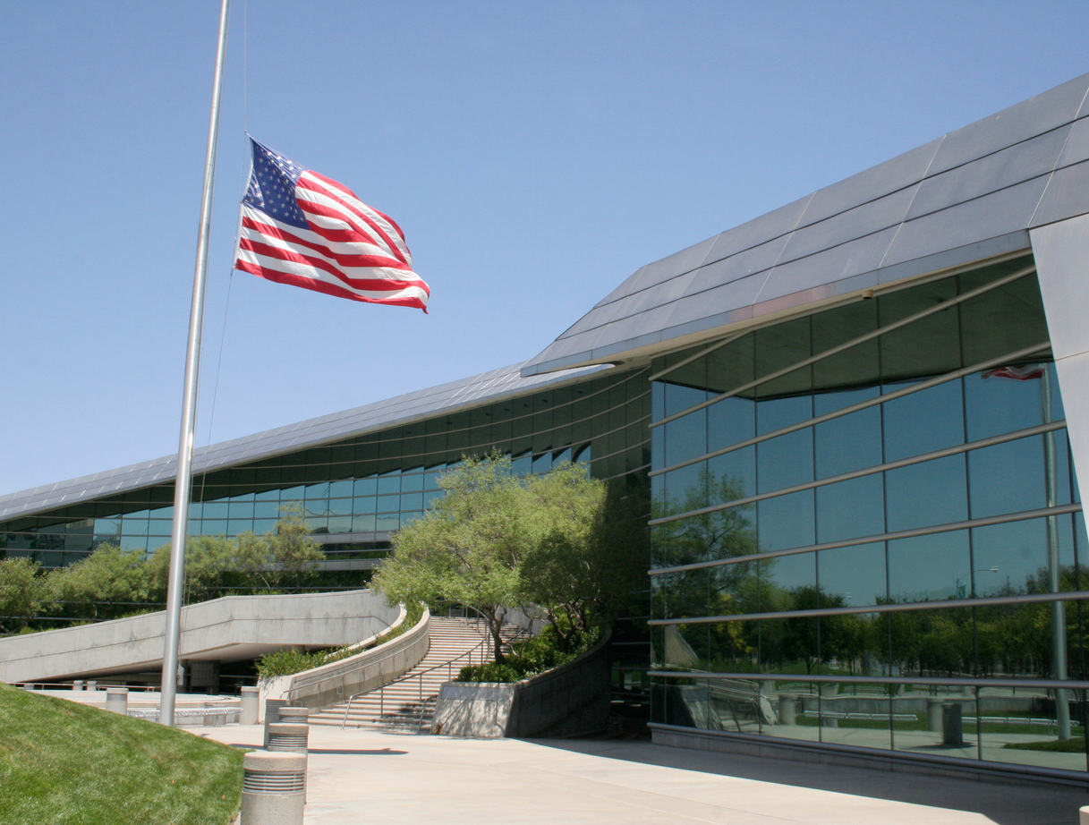
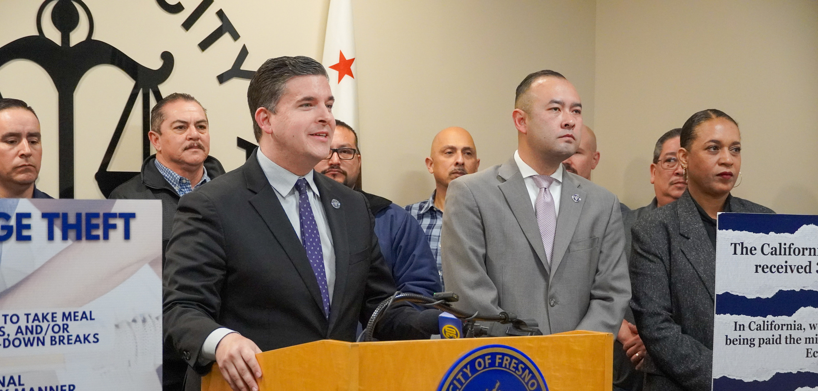
What is the City of Fresno’s
Wage Protection Program
The City of Fresno’s Wage Protection Program is a city-led initiative designed to combat and prevent wage theft, ensuring that workers within the City of Fresno receive the compensation they are legally owed.
Led by Councilmember Tyler Maxwell and the City Attorney Andrew Janz, this comprehensive program combines education for both workers and businesses, policy advocacy, and enforcement to address and rectify instances of wage theft across various industries within the city.

Slide 9
Wage Protection Program
How to file a complaint.
www.fresno.gov/cityattorney/fresno-wages
Website
Fill out Complaint Form
Submit Evidence
Investigation
Visit website: www.fresno.gov/cityattorney/fresno-wages
Fill out the complaint form
Gather and submit all evidence you may have as part of your complaint, upload any evidence to support your claim such as a log of hours worked, witnesses, manager information, etc.
CAO office will investigate your complaint and respond within 45 days

Slide 12
Wage Protection Program
What happens next?
City Attorney’s Office
The City Attorney’s Office (CAO) will investigate the complaint
Because this is a pilot program with limited resources, the CAO will focus on egregious cases and cases of impact
CAO will notify the employer of complaint without releasing employee or complainant information
CAO will notify you within 45 days of the status of complaint

Slide 13
Wage Protection Program
Wage Theft Complaint Process
City Attorney’s Office
Submit Complaint
CAO receives complaint and begins investigation
CAO gives employer notice
Criminal or Civil Liability
Go to CAO website
Investigation and evidence gathering
CAO may give employer notice and opportunity to respond without disclosing complainant information, may assign investigator
Negotiations + prosecution

Slide 14
Civil Liability
Criminal Liability
The Fresno City Attorney’s Office has the authority to criminally prosecute wage theft and prosecute employers in civil actions.
Wage Theft Protection Program

Slide 15
QUESTIONS?
www.fresno.gov

Slide 16
THANK YOU
www.fresno.gov

