Slide 1
City of Fresno
Boards and Commissions
Easy-to-Understand Guide
Mayor's Office of Community Affairs
Civic Academy

Slide 2
City of Fresno Boards and Commissions
Boards and Commissions:
Are vital to City of Fresno operation
Ensure public involvement in the governmental process
The City of Fresno has the responsibility to appoint individuals to a variety of boards, commissions, and committees supporting many areas of day-to-day business and future planning.
Fresno Mayor's Office of Community Affairs

Slide 3
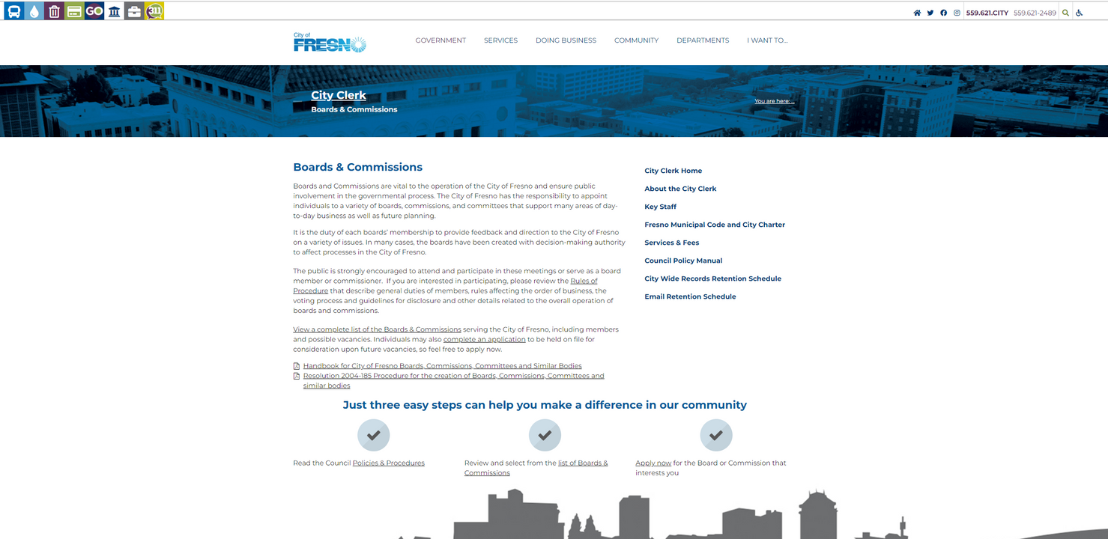
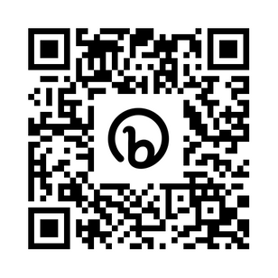
City of Fresno Boards and Commissions
City of Fresno Boards and Commissions website:
https://bit.ly/COFBandCMainPage
QR Code:
Fresno Mayor's Office of Community Affairs

Slide 4
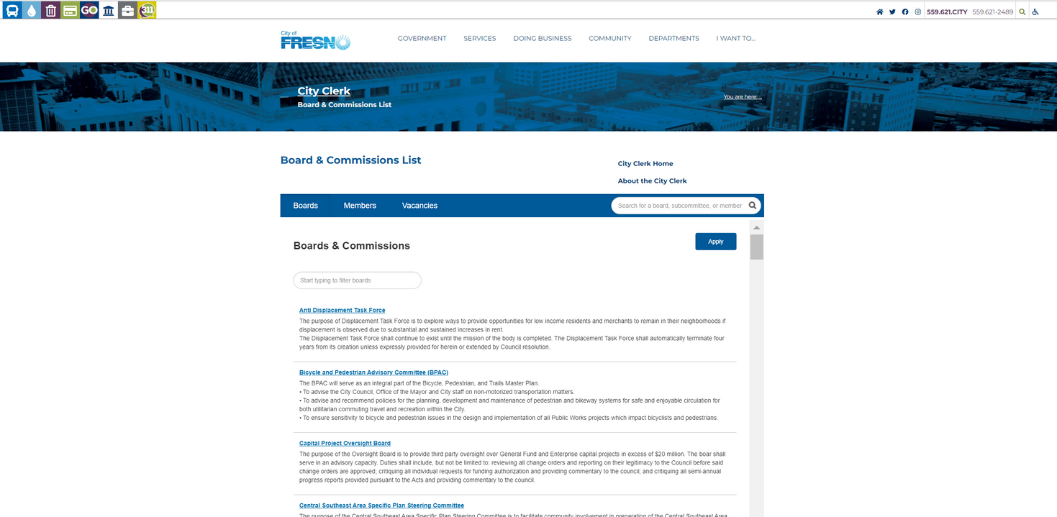
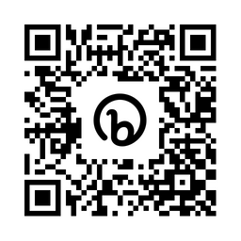
City of Fresno Boards and Commissions
City of Fresno Boards and Commissions listing site: https://bit.ly/COFBoardsAndCommissionsList
QR Code:
Fresno Mayor's Office of Community Affairs

Slide 5
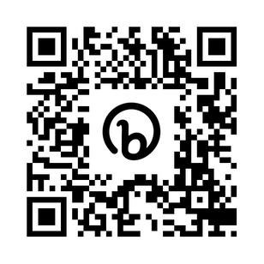
City of Fresno Boards and Commissions
City of Fresno Boards and Commissions application website: https://bit.ly/COFBandCApplication
QR Code:
Fresno Mayor's Office of Community Affairs

Slide 6
City of Fresno Boards and Commissions
For OCA assistance with
City of Fresno Boards and Commissions:
(559) 621-7923
Fresno Mayor's Office of Community Affairs

