Slide 1
FRESNO POLICE DEPARTMENT
Paco Balderrama, Chief of Police

Slide 2
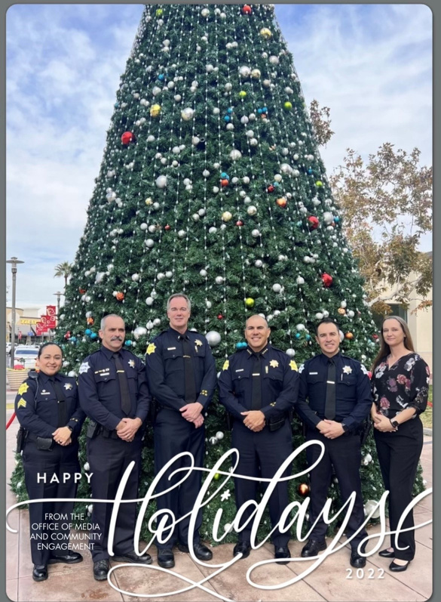
OFFICE OF THE CHIEF
OFFICE OF MEDIA AND COMMUNITY ENGAGEMENT
Responsibilities:
Administrative duties for Chief’s office
Public Information Officer for significant events
Manages department social media and marketing
Coordinates community activities

Slide 3
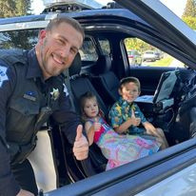
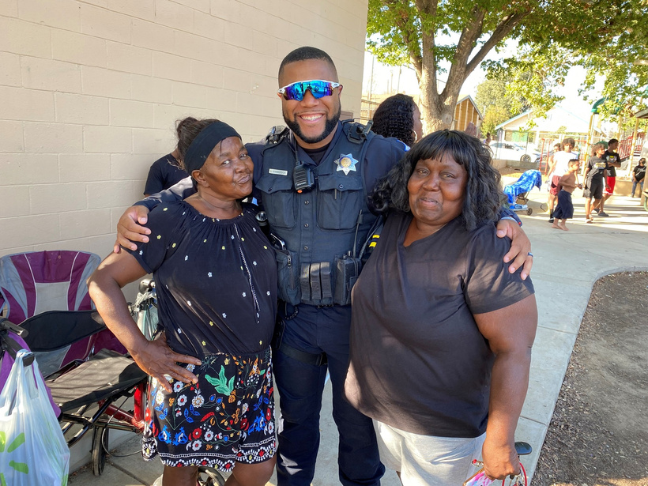
PATROL
Patrol Staffing: (per district)
One Captain
Two Lieutenants
11 Sergeants
80 Officers
Three Patrol Shifts
(Days, Swings, Midnights)
Investigations Team
District Safety Team
Patrol Responsibilities:
Response to life-threatening crimes in progress
Conduct preliminary criminal investigations
Identify crime trends
Develop solutions
Crime prevention

Slide 4
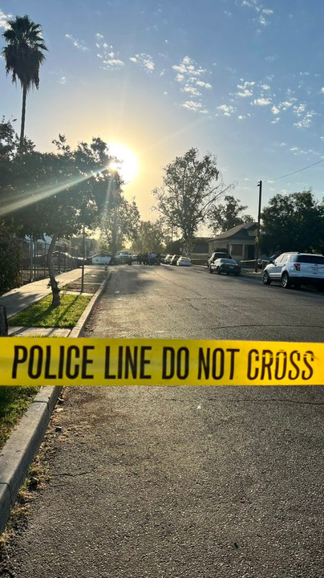
STREET VIOLENCE BUREAU
Homicide:
One Lieutenant
Two Sergeants
Twelve Detectives
Homicide Responsibilities:
Murders
Suspicious Deaths
In-Custody Deaths
Officer-Involved Shootings
100% of Murder Cases Charged in 2021

Slide 5
STREET VIOLENCE BUREAU
Street Violence Bureau Tactical Team:
One Sergeant
Six Officers
SVB Tac Team Responsibilities:
Undercover Surveillance and Apprehension
Armed Robberies
Carjackings
Home Invasions
Assault with Deadly Weapons
SVB Tac Team utilized in 250 investigations in 2021

Slide 6
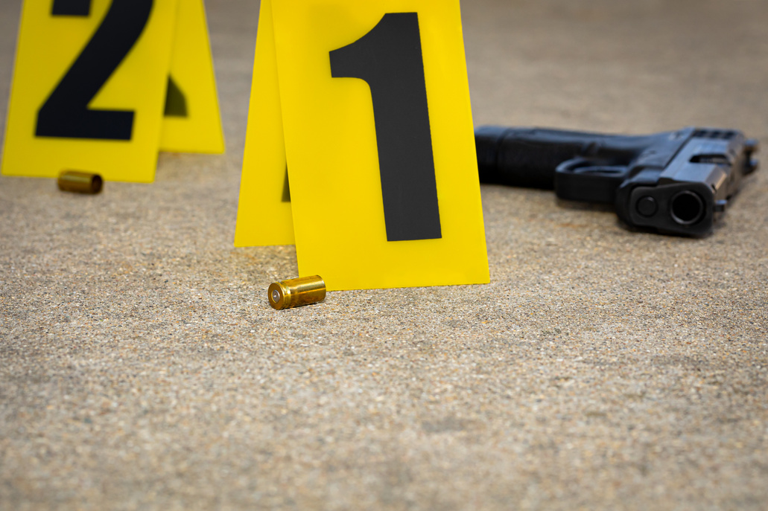
STREET VIOLENCE BUREAU
Night Detective Unit:
One Sergeant
Six Detectives
Night Detective Unit Responsibilities:
Homicides
Shootings
Robberies
Stabbings
Carjackings
Officer-Involved Shootings
Work Hours- 6:00 pm to 4:00 am - Seven days a week

Slide 7
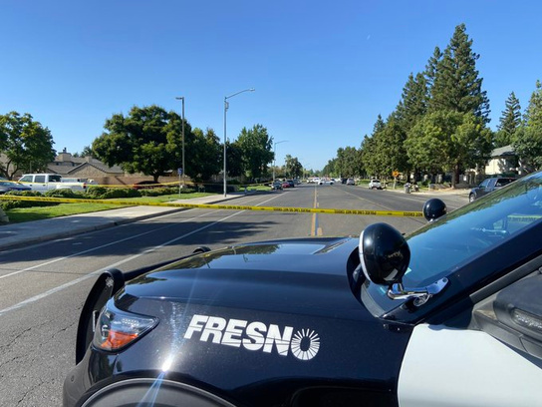
STREET VIOLENCE BUREAU
Felony Assault Unit:
One Lieutenant
One Sergeant
Eight Detectives
One Crime Analyst
2021:
600 cases
100 Arrests
60 firearms
Felony Assault Unit Responsibilities:
Attempted Homicides
Shootings
Stabbings
Assault with Deadly Weapons
Threats
Kidnapping for Ransom

Slide 8
M.A.G.E.C. BUREAU
Multi-Agency Gang Enforcement Consortium:
One Lieutenant
Three Sergeants
20 Fresno Police Department Officers
Metro and Rural Teams
Fresno Police Department
C.H.P.
Fresno County Sheriff’s Department
Fresno County District Attorney’s Office
Division of Parole Operations
Clovis, Kingsburg, Sanger, Parlier, Selma, Reedley, Mendota, and Kerman Police Departments
2021:
• 521 Felony Arrests
•160 Search Warrants
• 301 Firearms

Slide 9
FAMILY JUSTICE BUREAU
2021:
• 1,100 Cases
Sexual Assault/PC290 Unit:
Two Sergeants
Fourteen Detectives (Three PC290/Three cold case)
Cold Case Unit funded by Sexual Assault Unit Initiative
PC290 detectives monitor compliance of 1,780 sex registrants

Slide 10
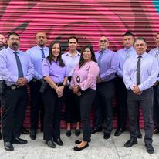
FAMILY JUSTICE BUREAU
Domestic Violence Unit:
One Sergeant
Nine Detectives
Two Marjaree Mason Center Advocates
2021:
• 6,100 Cases

Slide 11
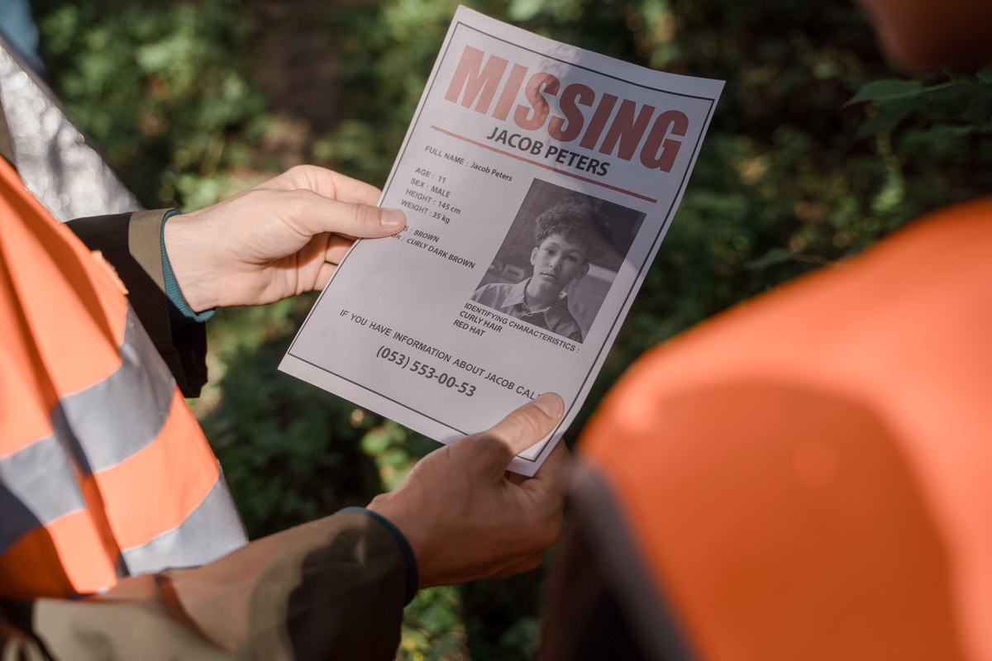
FAMILY JUSTICE BUREAU
Child Abuse/Missing Person Unit:
One Sergeant
Seven Detectives
Responsibilities:
Investigation of all
Missing Persons Cases
Accidents
Foul Play
Abduction
Run Aways
Potential Abuse
2021:
• 3,800 Cases

Slide 12
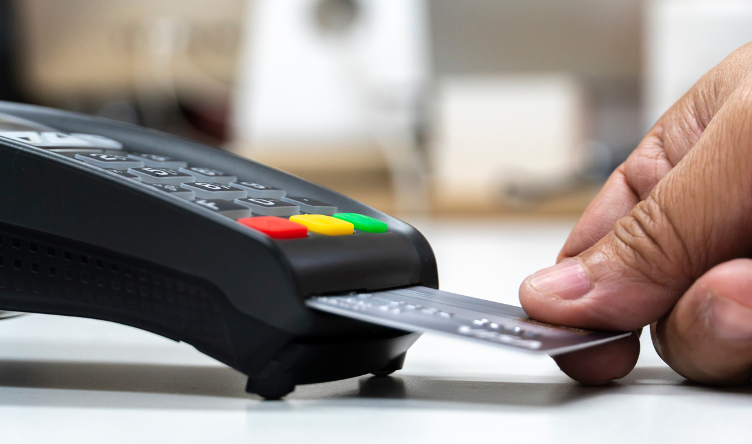
FAMILY JUSTICE BUREAU
Financial Crimes Unit:
One Sergeant
Four Detectives
Digital Forensic Lab-One Analyst
Financial Crimes Unit Responsibilities:
Fraud-Related Crime Investigations
ATM/Credit Card Fraud
Check Fraud
Social Media Scams
Real Estate/Notary Fraud
Fraud by False Pretense/Deceit

Slide 13
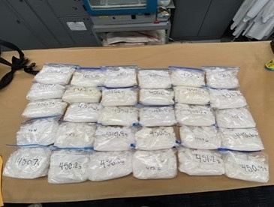
SPECIAL INVESTIGATIONS BUREAU
Narcotics/HIDTA:
One Sergeant
Nine Detectives
Major Narcotics Unit Responsibilities:
Investigations of large-scale narcotics sales
Works collaboratively with:
DEA
FBI
ATF
HSI
USPS
IRS

Slide 14
SPECIAL INVESTIGATIONS BUREAU
Vice/Intel Unit:
One Sergeant
Seven Detectives
Vice/Intel Unit Responsibilities:
Regulation of massage businesses
Gambling Houses
Human Trafficking Rescues
2021:
Vice started routinely investigating criminal street gang members involved in pimping

Slide 15
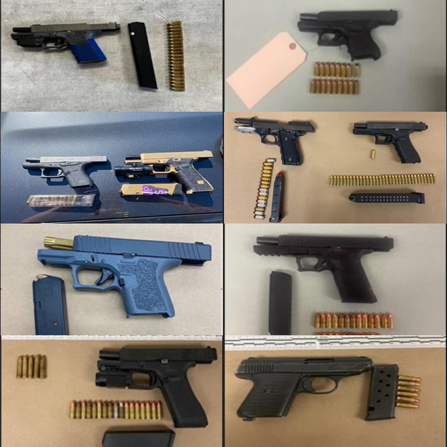
SPECIAL INVESTIGATIONS BUREAU
Gun Crime Unit:
One Sergeant
Six Detectives
Gun Crime Unit Responsibilities:
Investigation of gun crime cases

Slide 16
COMMUNICATIONS DATA ANALYSIS BUREAU
One Lieutenant
Six civilian supervisors
Authorized for 103 dispatchers
First Public Safety Answer Point for 9-1-1 calls
Calls assessed by dispatchers
Create calls for service
Route to other agency when applicable
2021:
•418, 779 9-1-1 calls
•517, 043 non-emergency calls

Slide 17
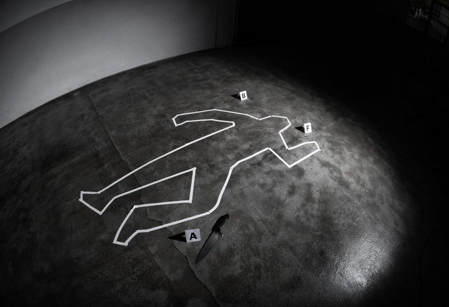
COMMUNICATIONS DATA ANALYSIS BUREAU
Crime Scene Investigations Section:
One Manager
19 Crime Scene Investigations Technicians
Housed at Headquarters
Responsibilities:
Specialized Crime Scene Investigation
Forensic Services
Crime Scene Processing
Evidence Photography
Expert Courtroom Testimony
Blood/DNA/Sample Collection
Major Crime Scene Diagram Construction
Latent Fingerprint Processing and Development
Operates:
24 hours a day, seven days a week

Slide 18
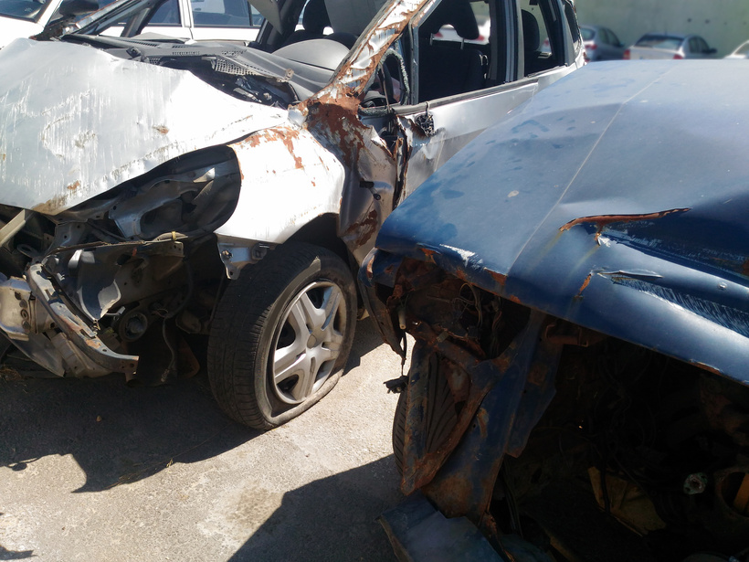
TRAFFIC SAFETY/SUPPORT SERVICES SECTION
One Lieutenant
Five Sergeants
34 Motor Officers
Seven Motor Detectives
(Three hit and run, three fatal investigations)
Administrative Staff
Operates:
19 hours a day, seven days a week
In 2021, The Collision Reconstruction Unit (CRU)
investigated 62 cases

Slide 19
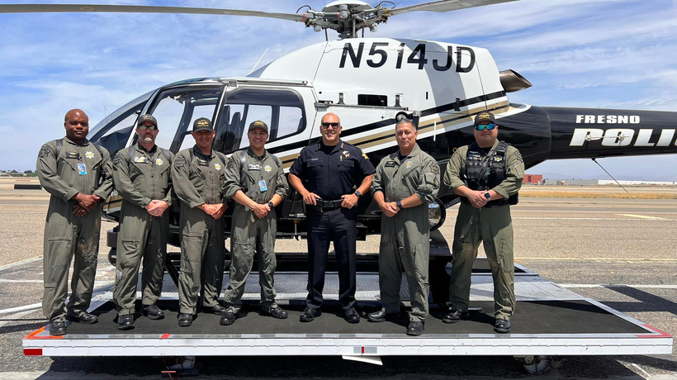
COMMUNITY RELATIONS/AIR OPERATIONS
2021
Flew over 1,675 hours
Assisted – In apprehension of 308 suspects
Assisted - 3,517 Calls for Service
74 Vehicle pursuits
First to arrive in 2,249 of those calls
Average response time: 31 seconds
One Sergeant
Five Police Officers
(Four Commercially Rated Helicopter Pilots)
Chief Pilot is also a Certified Flight Instructor
Two Civilian Employees/Aircraft Maintenance Crew

Slide 20
STUDENT RESOURCE OFFICER (S.R.O.)UNIT
Two Sergeants
Fourteen School Resource Officers
S.R.O.Responsibilities:
Fresno, Central, and Sanger Unified School Districts
Provide a safe environment for students
Increase trust between students and officers
Mentoring and Coaching to students

Slide 21
HOMELESS ASSISTANCE RESPONSE TEAM
H.A.R.T.
One Sergeant
Five Officers
H.A.R.T. Responsibilities:
Unhoused related issues
Provides safety and support to Fresno Sanitation
Collaborates with outreach programs
Provides services to those in need
H.A.R.T. Team acceptance rate of services-8.3%

Slide 22
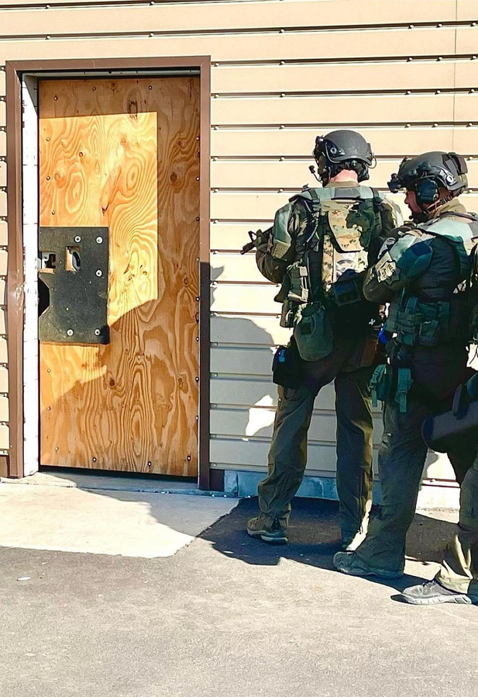
SPECIAL WEAPONS AND TACTICS
S.W.A.T.
S.W.A.T. Created in 1974
One Team Commander
Assistant Team Commander
Four Team Leaders
24 Operators
Responds to:
Hostage Situations
Barricaded Armed Subjects
Sniper Situations
Aircraft Hijackings
High-Risk Search Warrants

Slide 23
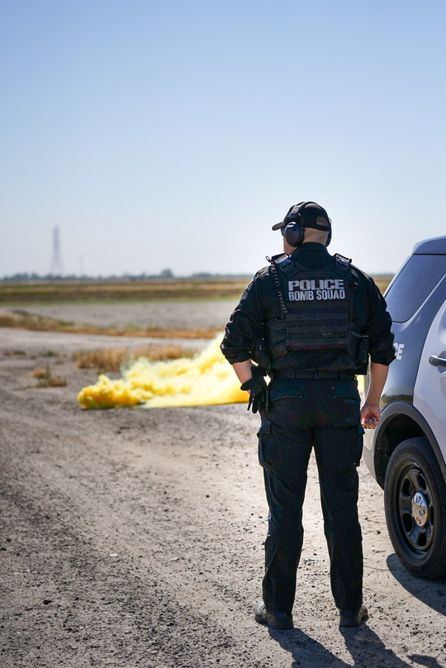
EXPLOSIVE ORDNANCE DISPOSAL UNIT
E.O.D.
Created in 1972
Specialty equipment:
EOD truck, robots
Locate, identify, and render safe suspected explosive devices

Slide 24
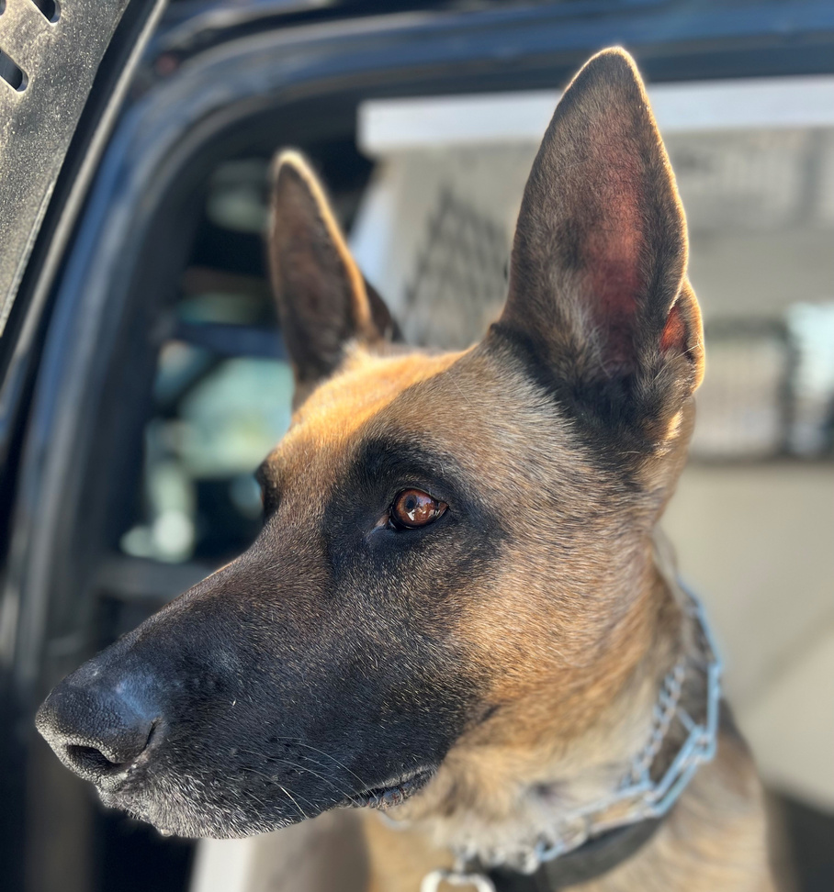
K-9
One Sergeant
Thirteen Officers
Two Support Staff
Responds to:
Crimes In Progress
Building/Yard Searches
Suspect Tracking
Article Searches
Public Education Demonstrations
Many K-9’s Cross Trained

Slide 25
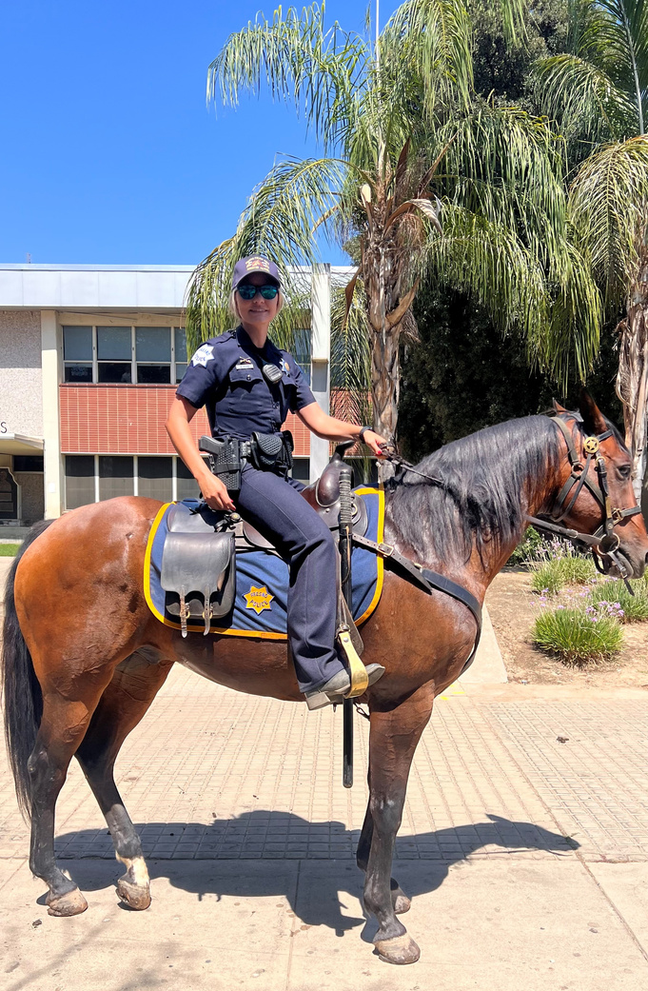
MOUNTED PATROL
Thirteen Riders
(Sworn and Volunteer)
Four Horses
Horses cared for seven days a week
Off-site facility
Barn
Horse Arena
Pens
K-9 Field
Obstacle Course for all service animals

Slide 26
CRISIS INTERVENTION TEAM
C.I.T.
One Sergeant
Five Officers
C.I.T. Responsibilities:
Collaborates with County Behavioral Health
Coordinated Mental Health Services to those in crisis
Entry Point to Mental Health Treatment and away from the Criminal Justice System

Slide 27
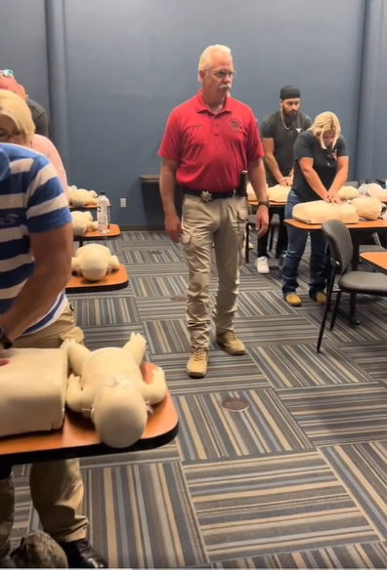
FRESNO POLICE DEPARTMENT REGIONAL TRAINING CENTER
Opened in 2010
78 Acres
Several Classrooms
Seven Firearm Ranges
200-Yard Rifle Range
Multi-Level Tower
Multi-Functional Tac-House
High-Speed Emergency Driving Track
Skid-pan
Primary Facility for FPD Personnel
Provides Training to other L.E. agencies

Slide 28
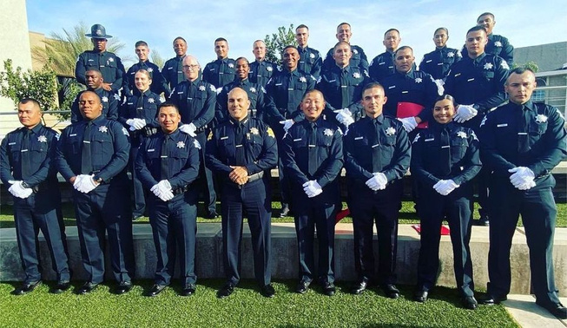
RECRUITING UNIT
One Sergeant
Three officers
Responsibilities:
Recruiting sworn and non-sworn personnel
Attend community events
Initial interviews
Training sessions for cadets
Maintains the department’s recruiting website
Skill Bridge Program
2022:
1,023 interviews
109 community events

Slide 29
INTERNAL AFFAIRS BUREAU
One Lieutenant
Six Sergeants
Two Professional Support Staff
Responsibilities:
Investigates allegations of misconduct
Fair and unbiased investigations
Findings retained for five years-per law

Slide 30
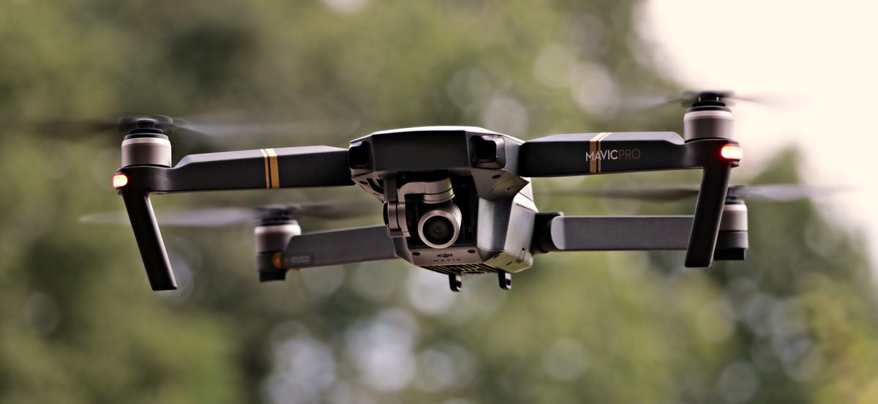
BODY-WORN CAMERA/SMALL UNMANNED AERIAL SYSTEM (SUAS) UNIT
One Sergeant
Four Officers
Two Professional Staff
Responsibilities:
Assign/manage-645 Body-Worn Cameras
Train officers in Body-Worn Camera usage
Maintain electronic docking stations
Video evidence storage
Share evidence with D.A.’s office in a timely manner
Oversees and maintains the Small Unmanned Aircraft System (sUAS)-Drones
Trains employees on the usage of the sUAS
60 sUAS currently deployed

Slide 31
FRESNO POLICE DEPARTMENT
Paco Balderrama, Chief of Police
9-1-1 Emergency
559-621-7000 Non-Emergency

