Slide 1
City of Fresno Mayor's Office of Community Affairs
Civic Academy | City Governance

Slide 2
Types of Municipal Governments
City government structures in California
Council-Manager
Mayor-Council
City-Commissioners
https://www.publicceo.com/2009/06/breaking-down-california-city-governments/#:~:text=According%20to%20the%20California%20League,San%20Diego%2C%20and%20San%20Francisco.

Slide 3
Fresno's Strong Mayor Government
“Strong Mayor” Form of Government
“Mini-Federal Government”
Mayor prepares budget for Council consideration
Mayor has veto power over legislature and budget acts
Mayor signs legislation into law
Adopted in 1993 and went into effect in 1997
Voted On and Adopted By the Citizens of Fresno
Offers a system of “Checks & Balances”

Slide 4
Fresno City Government Structure
Mayor serves as "Executive Head of the City" (similar to a CEO)
OVERVIEW
Mayor casts vision and direction
Mayor – CEO (Executive)
City Manager – CAO (Executive)
City Council – Board of Directors
(Legislative)
City Manager oversees all City
Departments and operations (Chief Administrative Office)
Executes the Mayor's vision
Council has power to make all laws
Council President presides over council
meetings; serves as chief Council spokes-
person; and signs all Council instruments

Slide 5
Strong Mayor vs. Council-Manager
Council-Manager
Strong Mayor
Mayor
Sits on Council
Participates in deliberations
Votes on issues
Council
Establishes polices
Passes local ordinancs
Has authority over City Manager – Assistant CEO (Executive)
Most power resides with the Council
Develops overall vision for the City
Mayor
Does not sit on Council
Has veto power
Power balance between Mayor and City Council
Develops overall vision for the City
Council
Establishes polices
Passes local ordinancs
Legislative power resides with the Council
SOURCE: https://www.publicceo.com/2009/06/breaking-down-california-city-governments/#:~:text=According%20to%20the%20California%20League,San%20Diego%2C%20and%20San%20Francisco.

Slide 6
Mayor's Powers and Duties
Power to appoint, direct and remove City Manager
Preparation of annual City budget for deliberation and approval
Veto power over all Council legislative and budgetary acts, except for:
Emergency ordinances
Site-specific land use decision
Administrative or quasi -judicial decisions
The power to promote economic development and the set the City's strategic vision for the city
Provides leadership and taking issues to the people and marshalling public interest

Slide 7
The City Manager
Appointed and removed solely from the Mayor (Council approval is not necessary)
Chief Administrative Officer for the city
Executes the Mayor's vision by managing and directing all city departments and employees
Participates in Council deliberations, but does not vote
Council is prohibited from giving direct orders to the City Manager or any subordinates

Slide 8
Powers and Duties of the Council
All city powers not allocated by Charter to other officials
The power to make all laws (subject of Mayoral veto)
Can override veto with a 5-vote supermajority
The power to appoint and remove the City Attorney and the City Clerk
Approve City Manger's appointment of the City Controller
Controls all City legal business and proceedings

Slide 9
The City Attorney
Appointed and removed by majority Council vote
Is the City's legal representative
Ensures all City actions comply with Due Process
Serves all city officials on legal matters pertaining to their duties
Is not a personal attorney for individual Councilmembers or the Mayor
Provides legal analysis and recommendations to the City Manager and Staff on on their business/policy decisions
Provides the Mayor and Council legal advice for consideration in their final business/policy decisions

Slide 10
The City Clerk
Appointed and removed by majority Council vote
Serves all city officials
Prepares the City Council meeting agenda, records council proceedings and is custodian of city records
Additional duties include:
Election
Conflict of Interest - Fair Political Practice Commission
Varied state and local law requirements

Slide 11
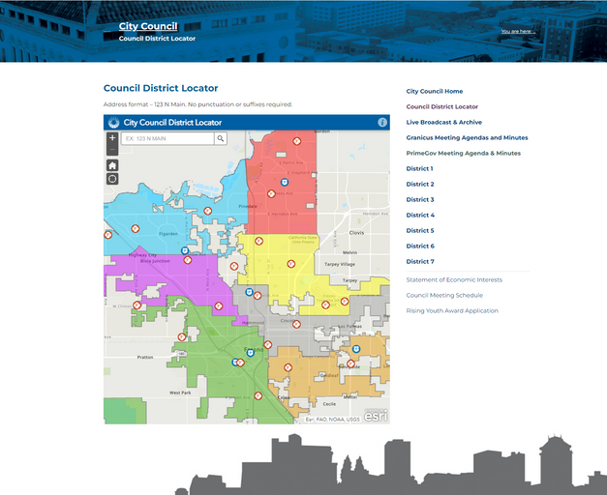
Locating your City Council District
Your house address
Look up the City District Map
https://www.fresno.gov/citycouncil/council-district-locator/
Locate your main cross streets
Identify your district and your City Council member

Slide 12
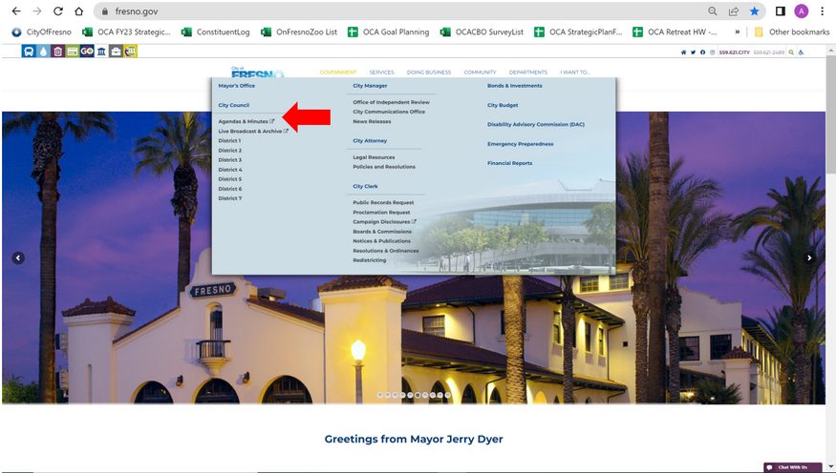
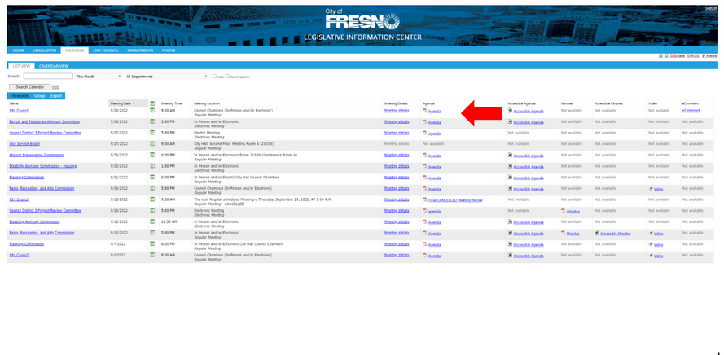
Locating Council Agenda
Visit the city website:
www.fresno.gov
Locate the following:
"GOVERNMENT" (top of page)
"City Council"
"Agendas and Minutes"
Council Agendas must be posted publicly a minimum of 72 hours prior to the meeting start

Slide 13
Conclusion
The Strong-Mayor form of government creates an inherent system of checks and balances
Presents unique policy implementation challenges
Requires efficient government operations
primarily, strong communication between the executive and legislative branches

