Slide 1
Department of Public Utilities
Brock D. Buche, PE, PLS
Director
November 16, 2022

Slide 2
Department of Public Utilities (DPU): Providing Life’s Essential Services
Deliver high-quality utility services professionally, efficiently, in an environmentally-responsible manner, to ensure the health and safety of our community
Preserve precious natural resources through recycling, responsible treatment of wastewater, timely collection of solid waste, and water conservation

Slide 3
DPU Overview

Slide 4
DPU Overview
Two Support Divisions
Administration
Planning & Engineering
Three Operations Divisions
Water
Wastewater Management
Solid Waste Management
Fiscal Year 2023 Budget
Operating budget: $189.8 million
Debt service: $26.7 million
Capital budget: $123.4 million
Total budget: $339.9 million

Slide 5
Administration Division

Slide 6
Administration Division
Administration
Staff = 10
FY 2023 Budget = $2.6 million
DPU Administration Responsibilities
Department coordination and strategic planning
Administrative guidance and support for the operating divisions
Community outreach coordination
Communication with City Administration and City Council
Coordination with external agencies and boards

Slide 7
Administration Division Utilities Planning & Engineering

Slide 8
Utilities Planning & Engineering (UP&E)
Staff = 46
FY 2023 Operating Budget = $4.2 million
Primary Functions
Capital Projects – engineering, bidding, construction
Long-range Planning (UWMP, Metro Plan, R&R)
Utility Plan Reviews
Operating Division Support
Well Drilling Permits
Development Coordination and Entitlements (tract maps, new constr)
Loan Programs (sewer connections, septic tanks destr)

Slide 9
Water Division

Slide 10
Water Division
Staff = 200
FY 2023 Operating Budget: $ 81.2 million
FY 2023 Capital Budget: $ 54.5 million
FY 2023 Debt Service: $ 23.3 million
FY 2023 Total: $159.0 million
The Water Division is responsible for the production, distribution, and delivery of clean, safe, and affordable drinking water to approximately 140,000 residential, commercial, and industrial accounts across a 114 square mile area

Slide 11
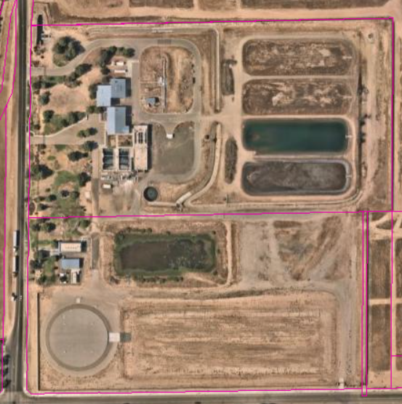
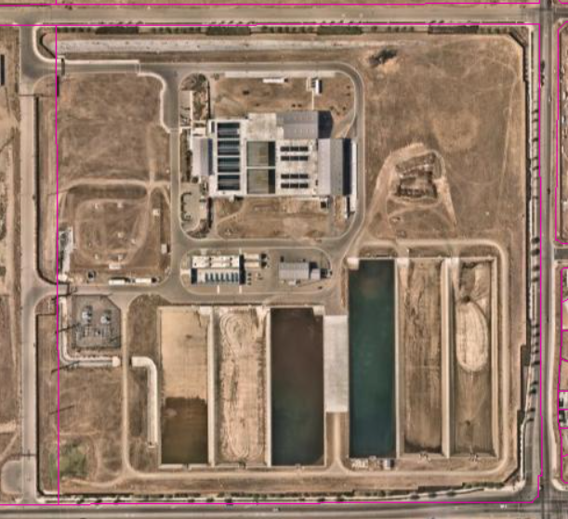
Water Production Facilities
Northeast Surface Water Treatment Facility
Commissioned in 2004
30 million gallons per day (MGD) capacity
T-3 Surface Water Treatment Facility
Commissioned in 2015
4 MGD capacity
Southeast Surface Water Treatment Facility
Commissioned in 2018
54 MGD permitted capacity
In future treat up to 80 MGD
Municipal Production Wells
265+ groundwater wells throughout the city
Pumps water from the underground aquifer

Slide 13
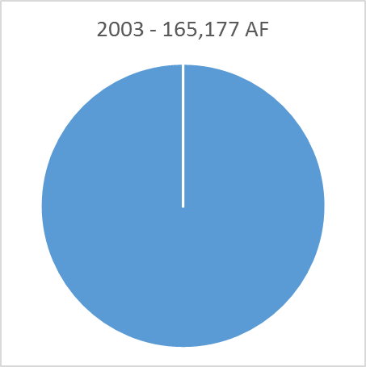
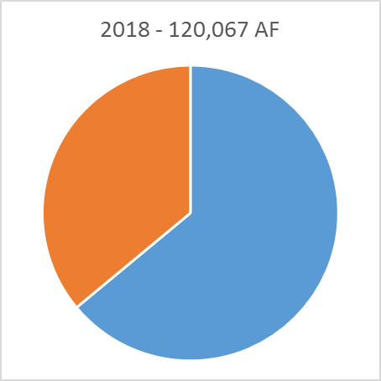
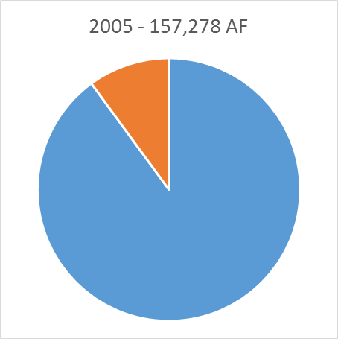
Water Supply Portfolio Change
100%
GW
36%
SW
64%
GW
Groundwater = 165,177 AF
Groundwater = 76,797 AF
10%
SW
53%
SW
47%
GW
90%
GW
Groundwater = 141,471 AF
Groundwater = 54,609 AF

Slide 14
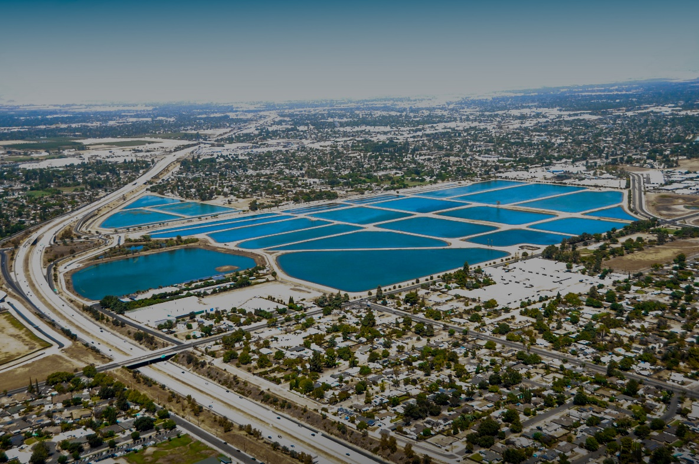
Groundwater Recharge Facilities
Intentional groundwater recharge is performed to replenish the aquifer beneath the city to ensure its long-term sustainable use.
Leaky Acres Recharge Facility
180 acres (1971)
26 percolation basins
Average annual recharge is about
16,000 acre-feet/year (AFY)
Nielsen Recharge Facility
30+ acres (2017)
2 large percolation basins
FMFCD Ponding Basins
73 percolation basins (1990)
Average annual recharge is about 44,000 AFY

Slide 15
Water Distribution System
Infrastructure
1,880 miles of distribution pipeline
Ranging in size from 4” to 66” in diameter
140,000 service connections (water meters)
13,000 fire hydrants
3 booster pump stations
3 water storage tanks
20,700 isolation valves

Slide 16
Water Quality
Safe Drinking Water
Ensuring the safety of the City’s drinking water
Water samples collected regularly from throughout the distribution system
Treatment and disinfection of water
Flushing of the distribution system
No-DES trucks avoid wasting water during this activity
Annual Water Quality Report
The City’s water supply has remained in compliance with all State and Federal water quality regulations at all times

Slide 17
Meter Shop & Backflow Prevention
Water Meter Shop
Maintains 140,000 water meters ranging from ¾” through 10”
Each service is equipped with an automated meter endpoint
Backflow Prevention Section: Cross-Connection Control
Manages over 9,700 backflow devices
Prevents the undesirable reversal of water flow or mixtures of water and other liquids into the distribution system
Travel Meter Program
Temporary Use of Fire Hydrant Permit
Issued for six (6) months maximum
Unauthorized use of a fire hydrant is subject to fines

Slide 18
Recycled Water Program
Recycled Water Distribution
Reuse of treated wastewater for beneficial purposes such as agricultural and landscape irrigation, industrial processes, and replenishing groundwater
Primarily in southwest Fresno
Delivery points include:
Roeding Park
Cemeteries
Ongoing expansion of the recycled water distribution system to increase capacity and make available for more customers

Slide 19
Water Conservation Program
Services Offered
Water-Wise Landscape Consultation
Irrigation Efficiency Audit
Irrigation Controller Assistance (Timer Tutorial)
Interior/Exterior Water Leak Surveys
Water Efficiency Survey & Analysis for Businesses

Slide 20
Water Conservation Program
Rebates Offered
Residential Toilet Rebate
Commercial & Multi-Family Toilet Rebate
Residential Clothes Washer Rebate
Lawn to Garden Rebate
Micro (Drip) Irrigation Rebate
High-Efficiency Sprinkler Nozzle Rebate
Smart Irrigation Controller Rebate
Rain Sensor Rebate
Swimming Pool Cover Rebate
Hot Water Recirculating Pump Rebate
Rain Barrel Rebate

Slide 21
Contact Information
Important Phone Numbers
After-hours water emergencies: (559) 621-1100
Water Conservation Hotline: (559) 621-5480
To report leaks, water-related concerns, and incidents of water waste
Call (559) 621-CITY (2489) or dial 3-1-1 within City limits
Submit a report in FresGO
Additional Information
(559) 621-5300
https://www.fresno.gov/publicutilities/XXXX

Slide 22
Wastewater Management Division

Slide 23
Wastewater Management Division
Staff = 178
FY 2023 Operating Budget: $ 53.6 million
FY 2023 Capital Budget: $ 65.0 million
FY 2023 Debt Service: $ 3.4 million
FY 2023 Total: $122.0 million
The Wastewater Management Division is responsible for the collection, conveyance, treatment, and reclamation of wastewater generated by the residential, commercial, and industrial sewer customers in the Fresno-Clovis Metropolitan Area

Slide 24
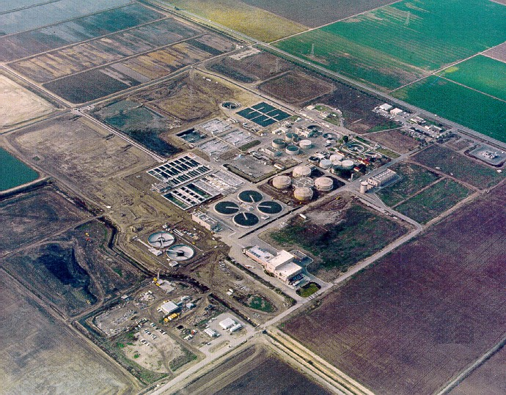
Wastewater Treatment Facilities
Fresno-Clovis Regional Wastewater Reclamation Facility (RWRF)
7th largest wastewater treatment facility in California
Receives and treats approximately 60 million gallons per day (MGD) of wastewater from the Fresno-Clovis Metropolitan Area
Permitted treatment capacity of 91.5 MGD

Slide 25
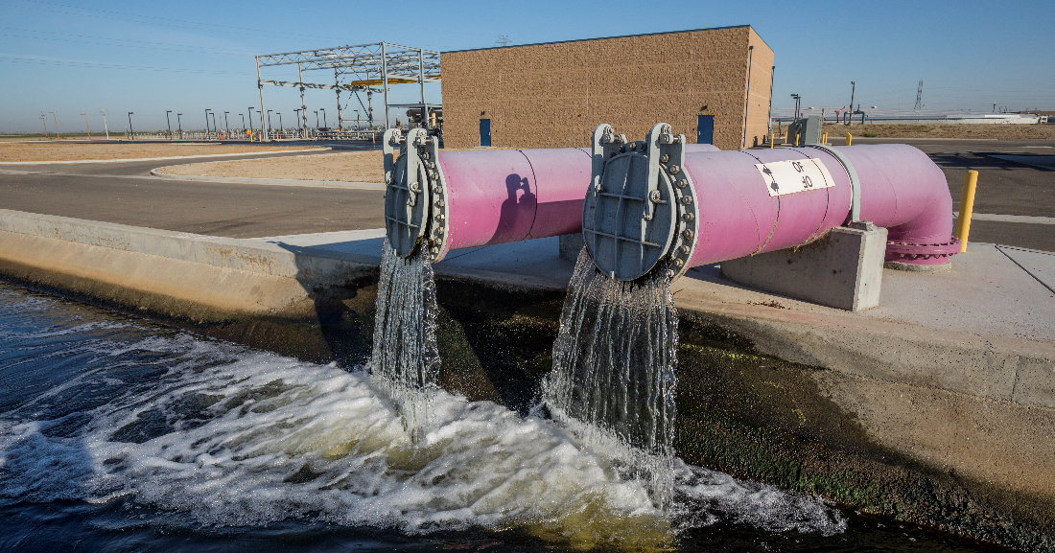
Wastewater Treatment Facilities
Recycled Water (Tertiary) Treatment Facilities
RWRF: 5 MGD Plant
North Fresno Wastewater Reclamation Facility 0.71 MGD
Combined, the two facilities treat an average of 5 MGD recycled water per day to tertiary standards

Slide 26
Recycled Water Production
Recycled Water
Recycled water is used for beneficial purposes such as agricultural and landscape irrigation
In 2021, the RWRF delivered approximately 2.2 billion gallons of recycled water
That’s enough to fill ~3,300 Olympic-sized swimming pools.
The City maintains approximately 17.8 miles of recycled water distribution pipeline (purple pipe)
Using recycled water reduces the need to use drinking water for non-potable uses

Slide 27
Collection System Maintenance (CSM)
Collection System
The collection system is comprised of approximately 1,593 miles of pipes ranging from 6” to 84” in diameter that convey over 60 million gallons of sanitary sewer per day to the RWRF
Related infrastructure maintained by the CSM workgroup includes
25,000+ access structures (manholes)
17 sewer lift stations
CSM workers are on duty 24/7/365 to respond to any sewer emergencies
Report all sewer-related emergencies by dialing 3-1-1 within the City limits or call (559) 621-CITY (2489); or report the issue in FresGO

Slide 28
Environmental Controls
Wastewater Discharge Pretreatment Program
Regulates industrial wastewater discharge from Significant Industrial Users who discharge an average of 25,000 gallons per day or more
Wastewater Discharge Permits are issued locally to:
Packing Houses
Industrial Laundries
Rendering Facilities
Bottling Companies
Food Processors and Manufacturers
Electroplaters
Metal Finishers
The Pretreatment Program has successfully reduced regulated pollutants discharged to the RWRF by more than 50%

Slide 29
Additional Wastewater Services
Reclamation Well Water Program
Non-potable water fill station
Hauled Liquid Waste Program
Septage disposal services
Fats, Oils, and Grease (FOG) receiving station

Slide 30
Contact Information
RWRF Tours
Tours can be requested by emailing RWRF.WastewaterTours@fresno.gov
Additional Information
(559) 621-5100
https://www.fresno.gov/publicutilities/sewer-wastewater/

Slide 31
Solid Waste Management

Slide 32
Solid Waste Management
Staff = 195
FY 2023 Operating Budget: $ 48.1 million
FY 2023 Capital Budget: $ 3.9 million
FY 2023 Debt Service: $ 0.0 million
FY 2023 Total: $ 52.0 million
The Solid Waste Management Division is responsible for the collection of residential green waste, trash, and recycled materials
Trash is delivered to the Cedar Avenue Recycling and Transfer Station (CARTS)
Recycling is delivered to Mid Valley Recycling Facility and CARTS
Green waste is delivered to Green Valley and West Coast Waste

Slide 33
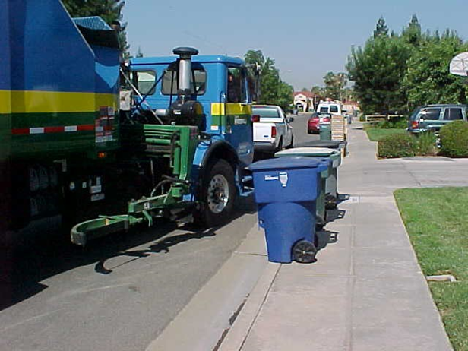
Residential Collection Service
Primary Responsibility
3-cart waste collection service for over 116,200 residential accounts
Carts
Green – Green Waste
Gray – Trash
Blue – Recycling

Slide 34
Residential Collection Service
Fast Facts
90 trucks
85 drivers
339,000 stops per week
27,000 miles driven per week
5,300 tons of green waste, trash, and recycling picked up each week

Slide 35
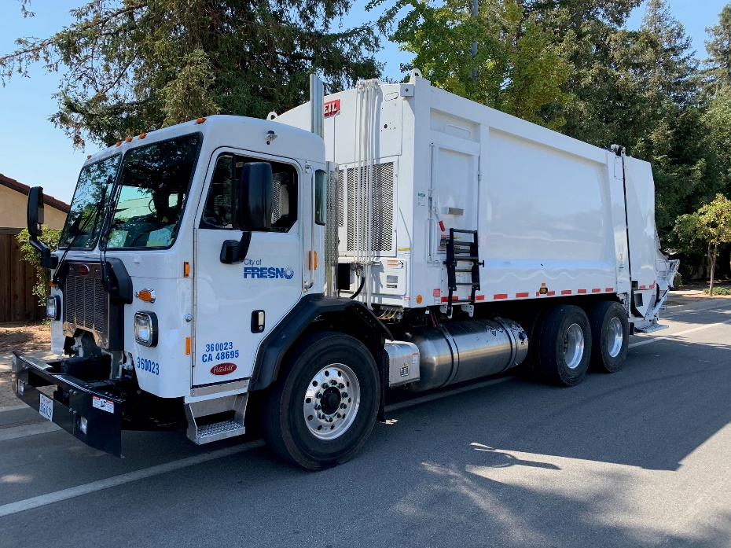
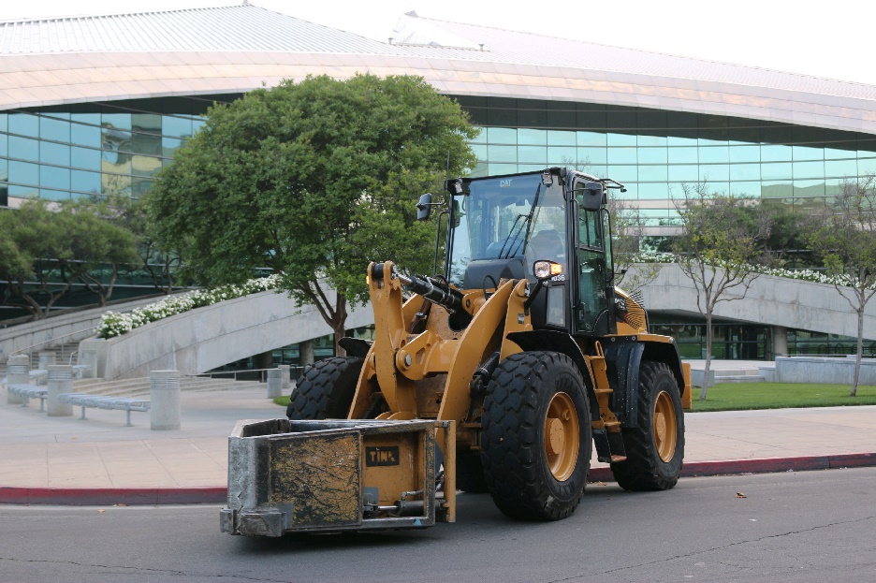
Field Services
Services Provided
Operation Clean Up
Litter Control
Homeless Assistance Response Team (HART)
Beautify Fresno
Container Maintenance

Slide 36
Field Services – Litter Control
Areas Served
Fulton District
Downtown
Chinatown
FresGO service requests
Other litter control projects as needed

Slide 37
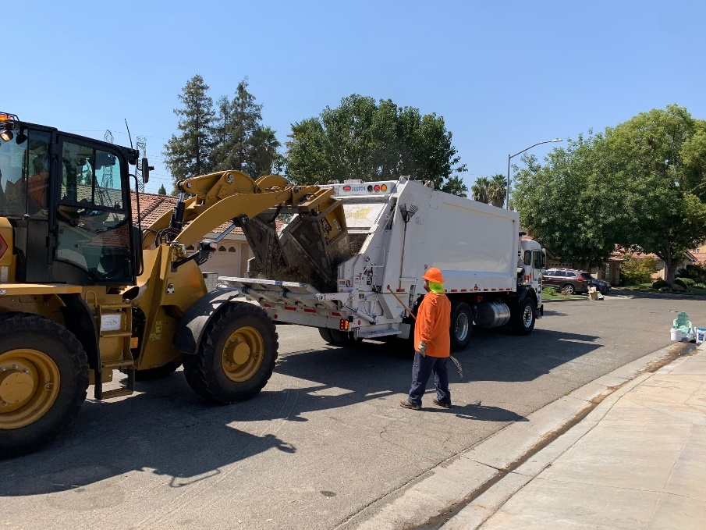
Field Services
Operation Clean Up (OCU)
Once a year service offered for single family residential customers
Designed to assist with the removal of excess trash, rubbish, and other bulky items (i.e. – stoves, water heaters, furniture, tree clippings, etc.) not picked up by the regular residential solid waste service

Slide 38
Field Services – Container Maintenance
Responsibilities
90+ service orders daily
Cart repairs
Cart washing/cleaning
Deliver new carts
Pick up abandoned carts
Deliver recycling receptacles for schools and outreach events

Slide 39
Field Services – HART
Homeless Assistance Response Team (HART)
Team comprised of personnel from:
Solid Waste field staff
Police Department
Code Enforcement
Personal property of homeless individuals is wrapped and tagged for pickup from a storage facility

Slide 40
Beautify Fresno
Beautify Fresno Program
This program facilitates community-based litter removal projects with the cooperation of private citizens, public agencies, private businesses, not-profit community based organizations, faith-based organizations, and volunteer community service organizations. In FY2022 the Beautify Fresno Program hosted 110 cleanup events, with over 12,500 volunteers picking up more than 150,000 pounds of trash, removing of graffiti, and planting hundreds of trees.

Slide 41
Recycling Program
Responsibilities
Regulatory compliance – waste diversion and recycling
AB 939 – 50% diversion
AB 333 – medical waste
SB 1383 – organics
Recycling education
Public outreach events
Grant management of $250,000 annually
Recycling Programs
Used Motor Oil and Filters
Beverage Containers
Mattresses

Slide 42
Recycling Education & Outreach
Education Programs
Approximately 120 presentations annually
Reaching an estimated 3,300 individuals
Presentations to students from preschool through high school
Presentations to community groups
Outreach Events
Attendance at approximately 30 events annually
Reaching over 10,000 attendees
Events include:
Cultural fairs
Resource fairs
Car shows
Home shows
Community and school events

Slide 43
Recycling Container Deliveries
School Recycling Programs
Grant from CalRecycle allows the City to offer free recycling receptacles to local schools to help start or enhance a recycling program on campus

Slide 44
Additional Solid Waste Services
Free Dump Days
4 events per year for City solid waste customers
Spring & Fall events (two days for each event)
Customers may deliver accepted materials to CARTS for free disposal
Assistance for Customers with Disabilities
Drivers roll out carts and return them to original location
Offered for customers with medical conditions or disabilities
Call (559) 621-1452 for eligibility requirements

Slide 45
Contact Information
To Report a Missed Pickup
Call (559) 621-6888 after 6:30 p.m.
Submit a report through FresGO
Additional Information
(559) 621-1452
https://www.fresno.gov/publicutilities/trash-disposal-recycling

Slide 46
Mobile App Downloads
Eye on Water
https://fresno.eyeonwater.com/signup
FresGO
https://iframe.publicstuff.com/#?client_id=806

