Slide 1
Southeast Development Area
Public Workshop #3
May 31, 2022
Notes:
Sophia to provide intro – remember to mention the logistics of the workshop – presentation, open house, survey station – pass it to Jennifer

Slide 2
Presentation:
Background
Why Now
What We heard
Next Steps
Notes:
Good Evening I’m Jennifer Clark the Planning and Development Director for the City of Fresno and I will walk you through the presentation tonight. As Sophia mentioned, the workshop will consist of a presentation followed by an open house where you can ask subject matter experts any questions you have.
This is the third and final workshop for the Southeast Development Area Specific Plan, better known as SEDA. How many attended one or both of the previous workshops?
Tonight, I will provide a brief recap on the background of SEDA and why we are updating the Plan, but most of the presentation will be focused on what we heard at the previous two workshops and how the existing policies address those concerns.
I will finish by recapping the next steps in the planning process and how you can continue to engage and comment on the plan

Slide 3
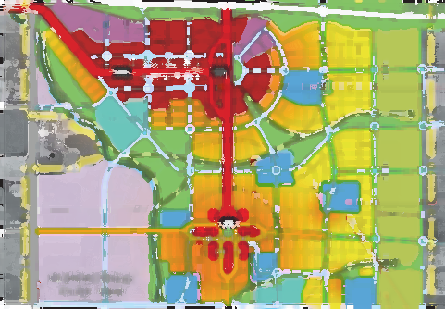
Background
Notes:
Before we get started let's review how we got here in the first place.

Slide 4
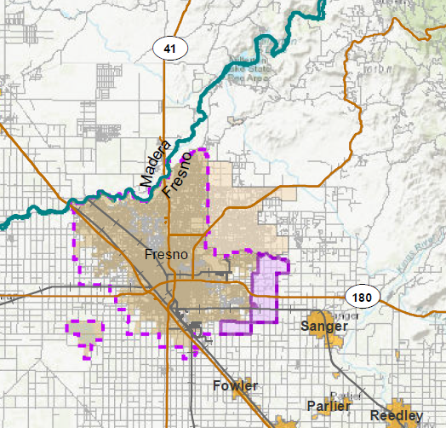
SEDA
Notes:
The Plan Area for SEDA can be seen here. It is the easternmost portion of the City’s Sphere of Influence, which is the identified physical boundaries and service area of the City.
The Plan Area was considered for incorporation into the Sphere of Influence long before the Planning process began.

Slide 5
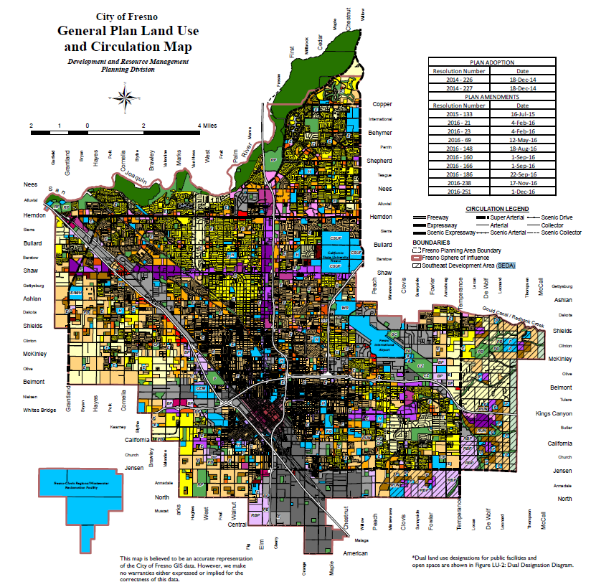
SEDA approved for incorporation into the City in 2006
Specific Plan and environmental assessment required
Notes:
Requirements for the eventual development of SEDA included the need to complete a Specific Plan for the Plan Area and the required environmental assessment for the plan.
As several of you know, this process started in 2006 and was put on hold in 2008 due to the recession. At that time, the City decided to embark on a new General Plan that would contemplate how the City would grow over the next Several Decades.

Slide 6
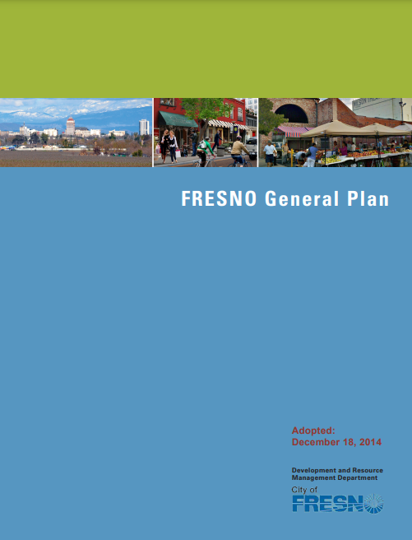
Notes:
The General Plan process was extensive and where SEGA became SEDA.
SEDA, and the need for a Specific Plan, are identified in the General Plan that was adopted in 2014. The General Plan identified the need for the Specific Plan to plan for orderly development for the area.
The General Plan makes it clear that the Specific Plan is needed to establish the scale and intensity required to support the vision for the Plan Area and associated financing requirements.

Slide 7
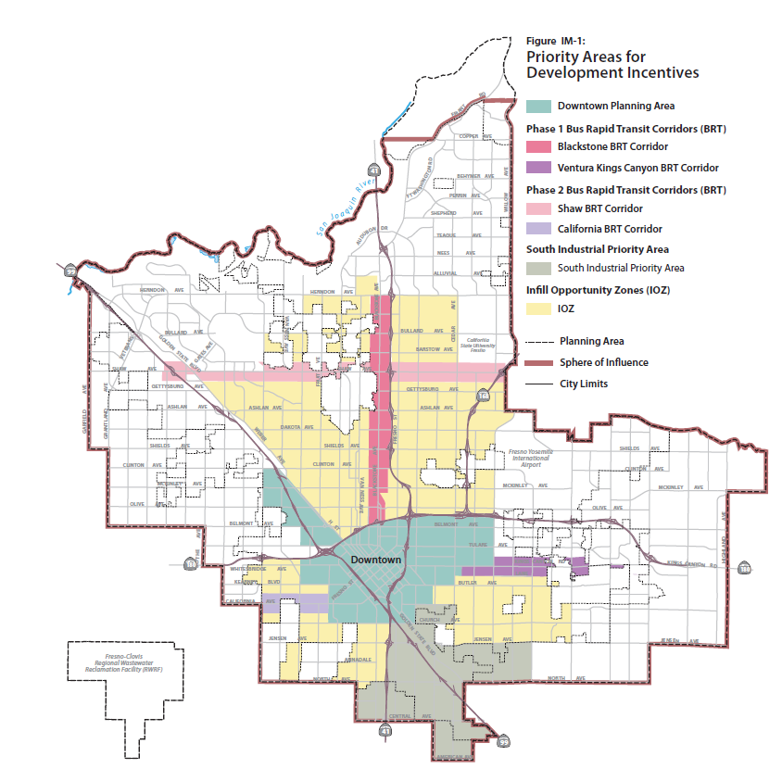
Notes:
The General Plan identified priority areas that would be the primary focus for the City, within the city limits as of 2012.
This map shows the primary areas where incentives should be established to stimulate development, but the General Plan also identified areas where the City would grow to achieve its full buildout

Slide 8
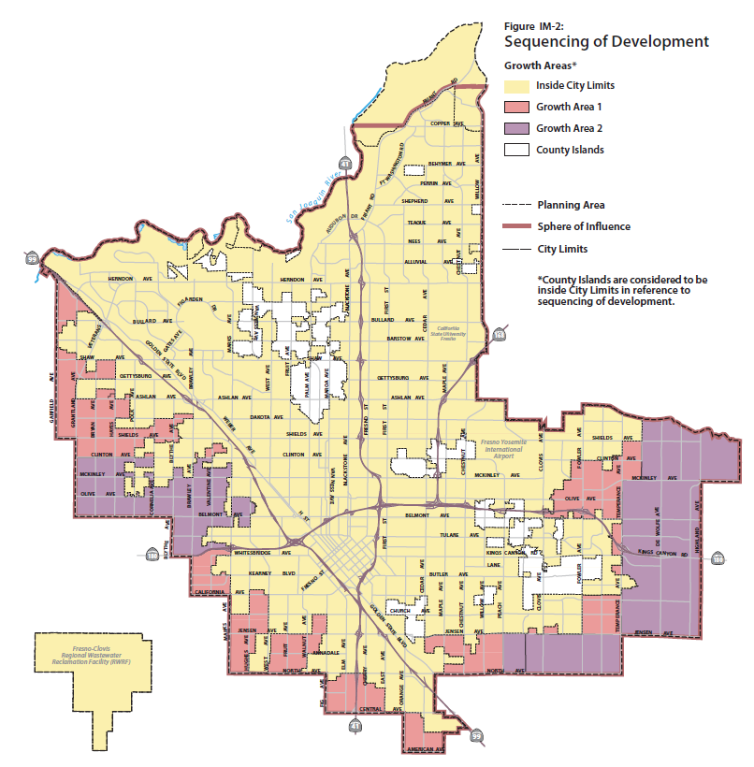
Notes:
These areas are known as Growth Areas and are identified in this map.
As you can see, SEDA, as well as parts of West Fresno are identified as Growth Area 2.
It should be noted that most of the areas identified as Growth Area 1 have recently completed or near completed Specific Plans – Southwest and West Area, west of 99.

Slide 9
Why Now
Notes:
This gets us to the Why now question

Slide 10
Why Now
Since the beginning of 2020, Fresno has seen a dramatic increase in demand for housing that is straining local families
The SEDA Specific Plan is identified in the City’s General Plan:
The development area where full buildout will occur that requires a Specific Plan In SEGA,
To be developed to the scale and intensity required to support financing structures for public infrastructure, and ongoing maintenance and public service costs
As a response the City of Fresno is now finishing the SEDA Specific Plan and completing an Environmental Impact Report (EIR).
Notes:
To plan for the full buildout of the City a plan must be created to ensure that the development happens in an orderly fashion and considers all the needs that will be required to create complete neighborhoods and not a patchwork with incomplete areas in between.
The City, not unlike most other cities, is in a housing crisis and needs to plan accordingly to ensure the crisis is addressed and the City is in a position in the future to respond to the ever-changing market
As mentioned in the previous slides, the Specific Plan and associated environmental assessment were included anticipated in the General Plan and are being completed to address the housing and growth needs of the City.

Slide 11
What We Heard
Notes:
Now, I’m going to review what we heard in the previous workshops

Slide 12
Public Outreach Purpose
Reintroduce the Specific Plan
Refresh the initial project activities of 2008
Solicit input and feedback on implementation and phasing
Gather input on the existing conditions of the SEDA Plan Area
Gather concerns about the Plan and how it could negatively impact those who live in the Plan Area now
Affirm with the public whether the primary concerns have been acknowledged (Why we are here tonight)
Explain why the City of Fresno has a renewed focus in the Plan after nearly a 15 years of project dormancy
Explain next steps of the project and when public comment may be given
Notes:
The objectives of the outreach are to reintroduce the Specific Plan and why it is being started again, to get an understanding of the Plan Area today and what the challenges are, and listen to the existing community on their concerns.
Through the listening process, we want to make sure that we confirm with you what we heard and let you know how we will use that information and how to stay engaged

Slide 13
Public Outreach to date
First Workshop: Tuesday, May 5, 2022
Topic: Learn about the SEDA Plan
80 attendees
Second Workshop: Tuesday, May 17, 2022
Topic: Have a say on the SEDA Plan
74 attendees
Comment cards responses
28% of Attendees submitted a Comment Card
75% were Residents
72% Business and/or Property Owners
55% provided written questions or comments
At each workshop feedback on presented topics within the SEDA plan where 200 additional questions and comments were collected
Notes:
Over the last two workshops, we had over 150 participants
Not all participants filled out the comment cards, but those that did showed us that there was a good representation of residents and business or property owners.
Additionally, you may have noticed that staff took several notes during the activities to get a full understanding of the concerns and what needed to be further addressed or modified in the Specific Plan
The responses in the comment cards varied, but one-fifth of them indicated opposition to the plan. Not everyone completed a comment card, but we heard those in opposition loud and clear

Slide 14
Concerns with how the Specific Plan would impact existing residents
Opposition to the Specific Plan
Disagreement with the plan since its inception
Opposition Listening Session
Date: Tuesday, June 14th
Time: 6-8 pm
Location: Sequoia Elementary School,
1820 S Armstrong Ave, Fresno, CA 93727
Notes:
Many Workshop attendees are concerned with how implementation would impact those who already live there.
There was also a contingent of workshop attendees who expressed their opposition to the Specific Plan.
Their desire is for the Plan Area to remain in its current state.
It was stated by several attendees that such disagreement with the plan has existed from its inception.
The City of Fresno has decided to hold an additional listening session to catalog the views of those who are completely opposed to the SEDA Specific Plan.
The listening session will be held on June 14th at Sequoia Elementary School. I will cover this again in “Next Steps”

Slide 15
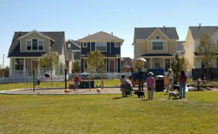
Land Use, Housing and Parks
Notes:
Now I will review what we heard related to 4 main topic areas and identify the existing policies that address those concerns
I want to point out that the policies listed do not completely address all of the concerns, and in the coming months' Staff will use what we heard to modify and add policies to further address the concerns
If you have any questions throughout this portion of the presentation please write them down on the comment card, and the Subject Matter Experts can answer them during the open house portion of the workshop

Slide 16
Concerns:
Concern of landscape changing from country to city
Concern over country landscape becoming suburban or urban landscape
Concern over potential loss of wildlife
Concern over potential loss of tight-knit community feel
Concern over loss of farmland
Notes:
Concern of landscape changing from country to city
Concern over country landscape becoming suburban or urban landscape
Concern over potential loss of wildlife
Concern over potential loss of tight-knit community feel
Concern over loss of farmland

Slide 17
Policies that address concerns
Policy CF-1.3 Conversion of Farmland to Non-Agricultural Uses – The City of Fresno will strongly discourage the conversion of strategic farmland outside its current SOI. The City Council called for no expansion of the SOI in the Fresno General Plan and will seek to promote and enter into agreements with the County and other cities to minimize such development.
Policy EO-4.4 Employment in Open Space Network– Develop the open space network to support employment opportunities.
Support small-scale farms in rural cluster areas
Support agricultural research in open space areas
Support the development of clean energy systems within the open space network (e.g., solar farms in parks, flood basins)
Policy OS-5.2 Habitat Corridors – Establish contiguous areas of passive open space to provide habitat corridors for local wildlife, including but not limited to riparian and canal greenway corridors, greenway/trail corridors, and parks and flood control facilities throughout the SEDA Plan. Habitat preservation shall be consistent and coordinated with the findings of the SEDA Environmental Impact Report and subsequent environmental studies and findings.
Notes:
The policies that look to address some of these concerns include policies that :
Ensuring strategic farmland is considered as the Plan Area develops
Establishing an open space network that includes components of the historic agricultural roots while also looking to provide employment opportunities
Making sure that the existing wildlife is planned for in new development and the open space in the plan area

Slide 18
Policies that address concerns
Policy OS-2.2 Passive Open Space – Support natural landscapes and wildlife habitat corridors by maintaining passive open spaces.
Policy CF-2.1 Rural Cluster Districts – Establish Rural Cluster Districts at the eastern edge of the site, as depicted in the SEGA SEDA Plan. Rural clusters consist of clustered residential development surrounded by common land held under easements for agricultural or recreational use.
Policy CF-1.4 Agricultural Farm Buffer – Establish an agricultural farm belt along the eastern edge of the SEDA. Farm belts provide opportunities to link agricultural land preservation and increased urban efficiency with local food production in ways that positively support local economies, farms, and farmers.
Policy CR-2.1 Small Farms & Community Farming – Support opportunities for entrepreneurs and families to grow food for commercial and household production within the SEDA (as specified in Community Farming and Agriculture Policy CF-3.1 and Policy CR-3.2).
Notes:
Additionally:
Creating open space that compliments the natural habitat
Establishing land use and associated development standards that concentrate housing in the town centers and transitions to lower densities as it fans out
Creation of an ag buffer on the eastern boundary and ensure there are opportunities for farmers to grow throughout the Plan Area

Slide 19
Concerns:
Not everyone wants development
Not everyone wants to remain rural
Concern about rural-to-urban transition
Concern over industrial concentration
Notes:
Not everyone wants development
Not everyone wants to remain rural
Concern about rural-to-urban transition
Concern over industrial concentration

Slide 20
Policies that address concerns
Policy EO-2.1 Collaboration with the San Joaquin Valley Clean Energy Organization (SJVCEO)– Work with the SJVCEO to attract projects and investments to Fresno and specifically the SEDA, promoting it as a key location in which to implement emerging clean energy. Local renewable energy projects can capitalize on Fresno’s abundant solar and biomass resources.
Policy CR-1.2 Conversion of Non-Urban Uses – Limit the conversion of culturally significant rural areas outside the current Fresno SOI by implementing the Farmland Conservation Model Program (as described in Community Farming and Agriculture Policy CF-1.2).
Policy CF-1.4 Agricultural Farm Buffer – Establish an agricultural farm belt along the eastern edge of the SEDA. Farm belts provide opportunities to link agricultural land preservation and increased urban efficiency with local food production in ways that positively support local economies, farms, and farmers.
Notes:
The policies that look to address some of these concerns include policies that :
Making sure that the City works with appropriate partners to limit the impacts of new development through clean energy projects
Limiting the conversation of culturally significant land and again through the creation of the Ag buffer

Slide 21
Policies that address concerns
Policy EO-1.4 – Promote industry clusters that build on Fresno’s local strengths - The SEDA Plan presents opportunities for each of the following clusters: Advanced Manufacturing, Clean Energy, Construction, Food Processing, Healthcare, Information Processing, Logistics & Distribution .
IMPLEMENTATION POLICY: Phasing Plan – Development of the Plan Area will need to be phased to be aligned with available infrastructure and facilitate orderly development.
Notes:
Additionally:
Promotion of the concentration of jobs, ones that complement the strengths of Fresno and the Plan Area
For the Plan Area to grow and consider all that was mentioned is to make sure it is phased appropriately – this will be done through the creation of a detailed phasing plan that considers all components needed for holistic development

Slide 22
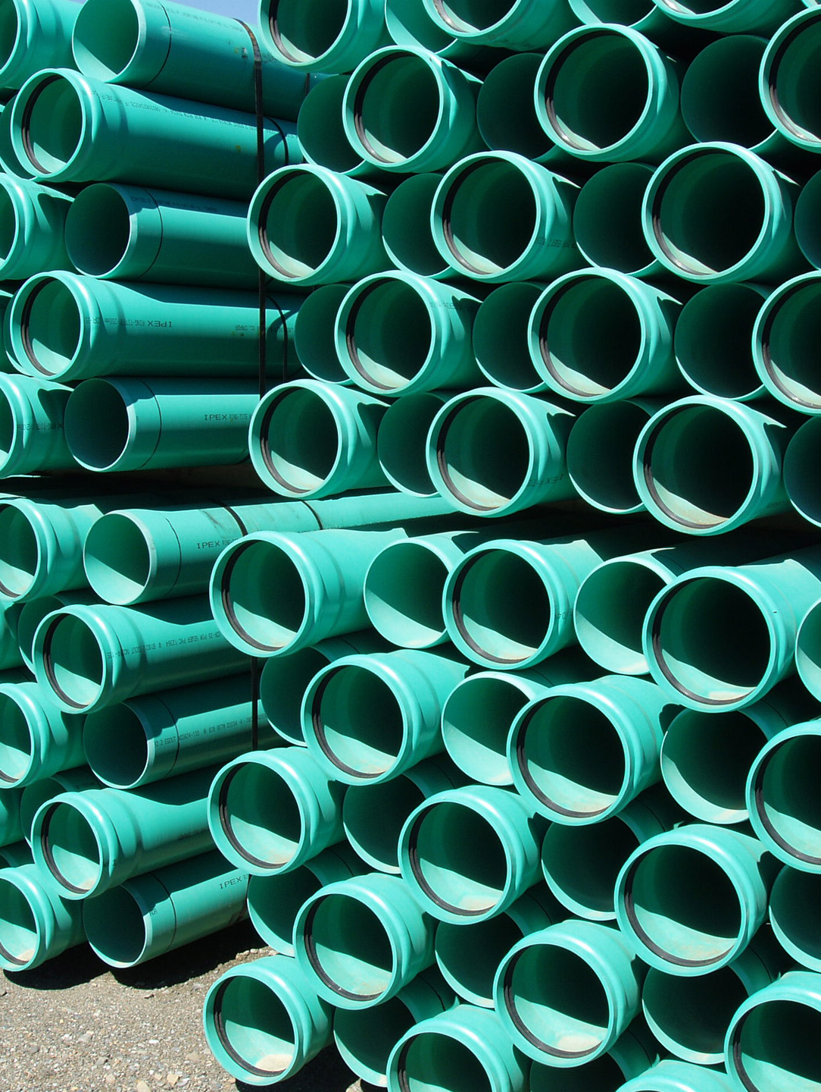
Water, Sewer and Storm Drainage
Notes:
Now I will review the concerns we heard with Water, Sewer and Storm Drainage

Slide 23
Concerns:
Concern over future groundwater levels
Concern over where the water will come from
Notes:
Concern over future groundwater levels
Concern over where the water will come from

Slide 24
Policies that address concerns
Policy RC-4.1 Minimizing Groundwater Extraction – Use available surface water supplies to meet as much of the SEDA’s potable water demand as possible, limiting groundwater extraction to extreme periods. The pending SEDA Infrastructure Assessment shall address this issue in detail.
Policy RC-4.2 Replacement of Extracted Groundwater – The North Kings Groundwater Sustainability Plan (approved in 2019) illustrates the decrease in groundwater levels in the region because of pumping. All groundwater drawn to serve development in the SEDA shall be replaced with at least an equal volume via infiltration, pumping, or other means. Recharge need not necessarily occur the same year as withdrawals; however, over time, total recharge must at least match total withdrawals. Recharge and withdrawals need not occur within the same groundwater aquifer but must be within the same groundwater basin. The pending SEDA Infrastructure Assessment shall address this issue in detail.
Notes:
The policies that look to address some of these concerns include policies that :
Ensuring that as much surface water as possible is used – the Infrastructure Assessment will address this and establish the best path
There are several statewide and regional policies that will need to be followed to make sure all water for the plan area is accounted for

Slide 25
Policies that address concerns
Policy RC-3.2 Water Recycling – Use treated wastewater for irrigation and other uses, consistent with applicable regulations, to minimize the required surface and groundwater needs of SEDA homes and businesses.
Policy RC-6.1 Water Supply & Delivery – Evaluate the potential surface water and groundwater resources and infrastructure needs necessary to meet the Southeast Development Area demand. Detailed assessments shall be addressed in the pending SEDA Infrastructure Assessment and EIR-related water infrastructure planning tasks.
Notes:
Additionally,
The Plan Area will require the use of several sources of water that will be used for a variety of uses
The Infrastructure Assessment will address this in detail and vital for the success of the Specific Plan

Slide 26
Concerns:
Concern over future water contamination
Concern over whether existing residents & businesses would need to tap into City water
Concern over being forced to tap into City water and being forced to pay for it
Concern over flood zones and storm water runoff
Concern over adding a sewer plant and where it would be located
Notes:
Concern over future water contamination
Concern over whether existing residents & businesses would need to tap into City water
Concern over being forced to tap into City water and being forced to pay for it
Concern over flood zones and storm water runoff
Concern over adding a sewer plant and where it would be located

Slide 27
Policies that address concerns
Policy RC-6.4 Shared Resources & Infrastructure – Develop methods and systems to share resources, infrastructure, and to capture the highest possible value for all public agencies. Resource-sharing strategies and plans shall be included in the SEDA Infrastructure Assessment.
Policy RC-2.1 Energy Planning – Support cooperative, multi-agency water and energy resource planning involving the City of Fresno and other local jurisdictions, water and flood control agencies, the San Joaquin Valley Clean Energy Organization and Pacific Gas and Electric Company.
Notes:
The policies that look to address some of these concerns include policies that :
- Planning for the required resources and infrastructure will be needed and where efficiency and partnerships can be identified

Slide 28
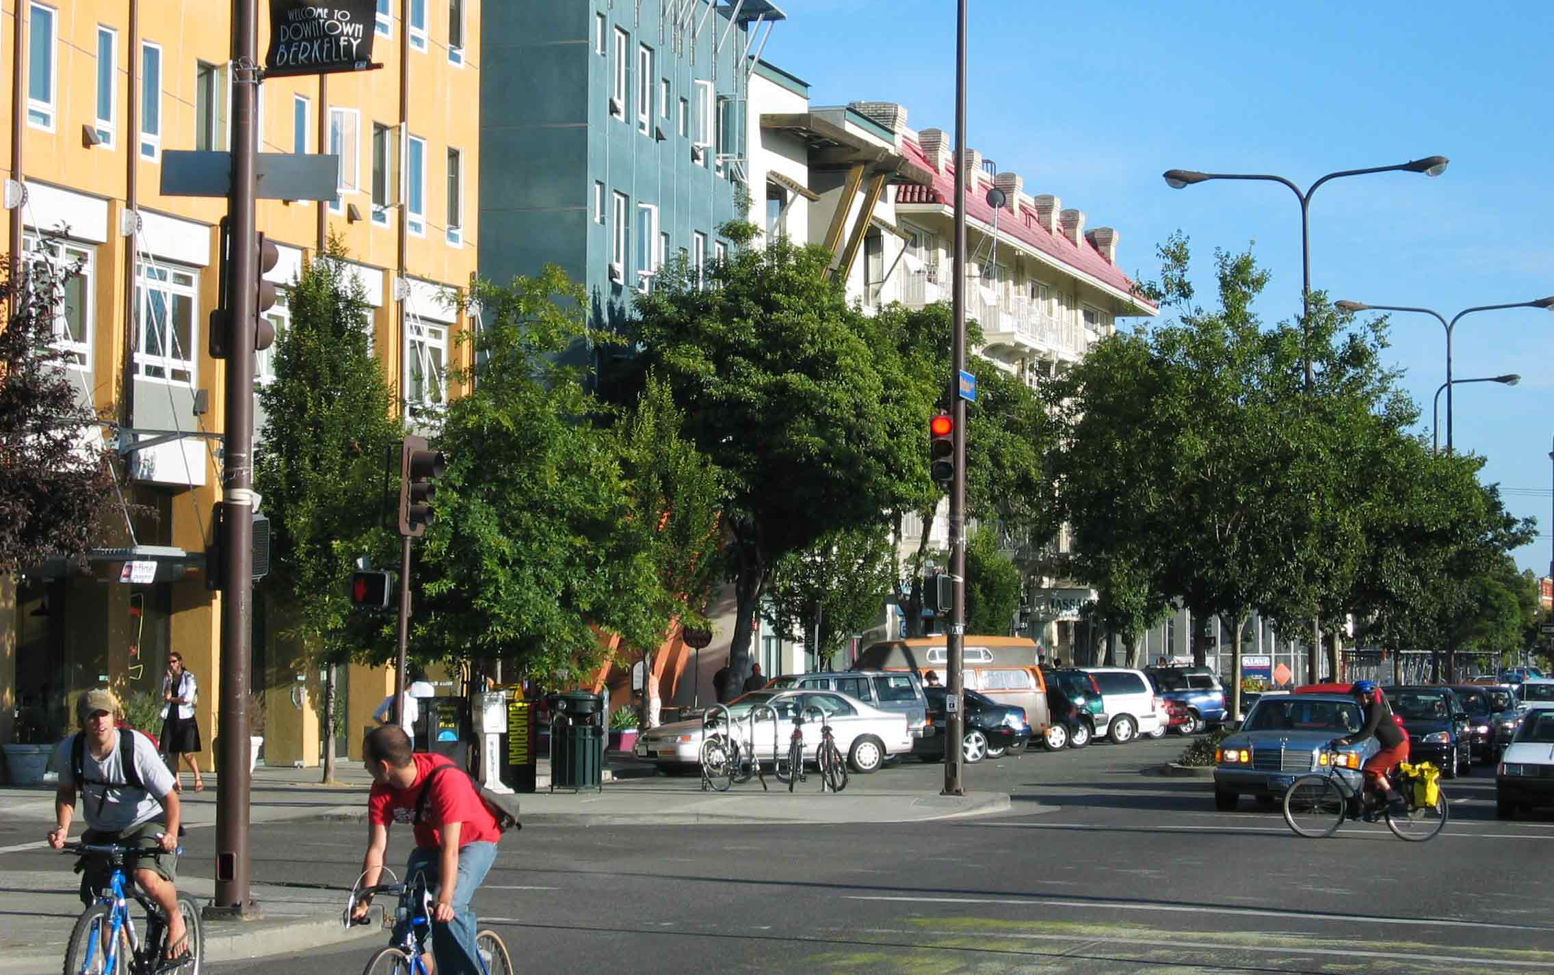
Environmental Sustainability
Transportation and Trails
Notes:
Now I will review the concerns we heard with Transportation and Trails

Slide 29
Transportation Concerns:
Roads should be completely developed at once instead of over time
Many existing roads currently in disrepair or not fully built
Temperance
Jensen
DeWolf
Concern over current traffic congestion (current & future)
Temperance
Jensen
Church
DeWolf
Kings Canyon
McKinley
Fancher
Notes:
Roads should be completely developed at once instead of over time
Many existing roads currently in disrepair or not fully built
Concern over current traffic congestion (current & future)

Slide 30
Policies that address concerns
Policy RC-1.1 Land Use Strategies – Link land use and transportation by incorporating following components into SEDA’s land use plan:
Complete Streets. Ensure that all streets in the SEDA comply with the City’s Complete Streets Policy.
Policy EO-5.2 Co-Location of Services & Employment– Co-locate services and employment to foster a walkable environment and allow for multi-purpose trips.
Policy RC-1.2 Transportation Facilities Strategies – Provide the following interconnected transportation facilities to encourage use of alternative modes of transportation and reduce vehicle trips:
Transit Facilities. Ensure adequate transit routes and facilities are provided in the SEDA through coordination between the Planning and Development and FAX Departments. Planned facilities should include bus stops, multimodal transfer centers and information kiosks.
Notes:
The policies that look to address some of these concerns include policies that :
Ensure that development is planned with all infrastructure is consider – this includes making sure the streets are built for all users and completed as the Plan Area develops
Establishing Land Uses and associated development standards that allow for residents to live near where they will work and have the ability to get there by walking or taking the bus

Slide 31
Policies that address concerns
Policy UF-5.4 Safe Streets – Environments designed for the safety of drivers, pedestrians, bicyclists, and transit users will be implemented in the Southeast Development Area according to the standards set by the City of Fresno Complete Streets Policy, adopted by the City Council on October 10, 2019.
IMPLEMENTATION POLICY: Infrastructure Study – An infrastructure study will be completed to identify all needed infrastructure, the related costs, and financing mechanisms to support the infrastructure.
Notes:
Additionally,
Making sure the streets that are built to ensure the safety of all users
This will be completed through the infrastructure study that will identify all the needed infrastructure, related costs, and financing mechanisms to support the infrastructure.

Slide 32
Trails Concerns:
Trails should be designed for pedestrian and bike safety
Trails should be designed with privacy and security in mind for adjacent property owners
Canal adjacent property lines often go to center of canals.
Concern over property rights.
Concern about encampments along trails
Several people voiced not wanting trails at all
Notes:
Trails should be designed for pedestrian and bike safety
Trails should be designed with privacy and security in mind for adjacent property owners
Canal adjacent property lines often go to center of canals. Concern over property rights.
Concern about encampments along trails
Several people voiced not wanting trails at all

Slide 33
Policies that address concerns
Policy RC-1.2 Transportation Facilities Strategies – Provide the following interconnected transportation facilities to encourage use of alternative modes of transportation and reduce vehicle trips:
Pedestrian and Bicycle Infrastructure. Ensure the SEDA is well-served by pedestrian and bicycle infrastructure, including sidewalks, bicycle lanes, bicycle paths and trails, and safe crossing infrastructure pursuant to the Active Transportation Plan.
Policy OS-4.2 Regional Trails – Establish planned network of multi-use greenway trails. Trails will serve bicyclists, pedestrians, and, where appropriate, equestrians. Cross sections and width requirements for specific conditions—including canal-side, open space, streetside, and farm-side trails.
Notes:
The policies that look to address some of these concerns include policies that :
Building the streets to allow for all types of users and is well connected to allow for coinvented and safe travel
Creating a trail system that compliments the natural landscape and can be used for all people in the plan area, even you that ride horses

Slide 34
Policies that address concerns
Policy UF-5.6 Performance Standards & Evaluation – The following criteria shall guide the evaluation of facilities within the SEDA:
Bicycle: A first-class bicycle network shall be provided. Bicycle lanes including Class II and Class IV facilities should be provided on all Super Arterials, Arterials, and Local Streets. A Bicycle Boulevard network should be designated on Neighborhood or Local Streets as illustrated in the SEDA Illustrative Detailed Area Circulation Plan (Figure 3.27). Safety of vulnerable users shall be prioritized and focus on creating a priority network of lower stress facilities to the extent feasible that will attract the “interested but concerned” riders and connect them to key destinations throughout the City as described in the Fresno Active Transportation Plan .
Pedestrians: A first-class pedestrian system shall be provided, including sidewalks on all streets, bicycle/pedestrian trails, and other design elements that prioritize safety and convenience for pedestrians as described in the Fresno Active Transportation Plan
Notes:
- The network that is created will need to provide options for all users, and the networks for those that will walk and ride their bikes will need to include the appropriate facilities and plan and built as the area grows

Slide 35
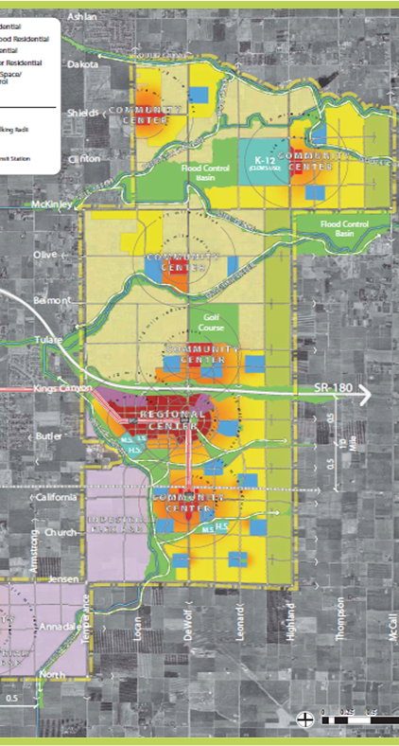
Implementation, Phasing and Annexation
Notes:
Lastly, I will review the concerns we heard with Implementation, Phasing and Annexation

Slide 36
Concerns:
City should require a higher percentage of infill development completed before annexing further
Some residents do not want to be annexed ever
Concern over annexation process, whether individual residents will have a say
Consider phasing west to east
Trails phased in as more density occurs
Notes:
City should require a higher percentage of infill development completed before annexing further
Some residents do not want to be annexed ever
Concern over annexation process, whether individual residents will have a say
Consider phasing west to east
Trails phased in as more density occurs

Slide 37
Policies that address concerns
Policy EO-5.1 Focused Activity– Concentrate office employment in the Regional and Community Centers and along transit corridors as detailed in the SEDA Plan.
IMPLEMENTATION POLICY: Annexation Procedures – Proactive annexation of groups of parcels may be necessary in order to facilitate orderly, phased development in the SEDA area. The City will develop proactive annexation procedures and a program to implement this key planning element.
IMPLEMENTATION POLICY: Phasing Plan – Development of the Plan Area will need to be phased to be aligned with available infrastructure and facilitate orderly development. A potential Phasing Plan is below, with each number indicating a 5-year Phase, leading to buildout in 20 years.
Notes:
The policies that look to address some of these concerns include policies that:
- Establishing land use and associated development standards that concentrate housing in the town centers and transitions to lower densities as it fans out
Creation of detailed policies and procedures for orderly development that does create gaps in infrastructure
For the Plan Area to grow to make sure it is phased appropriately is crucial – this will be done through the creation of a detailed phasing plan that considers all components needed for holistic development

Slide 38
PUBLIC WORSKHOPS: spring 2022
EIR comment period: Fall 2022
Plan Released: Summer 2022
Planning Commission Public Hearing(s) Winter 2022
City Council Public Hearing(s) Winter 2022
Implementation: 2023 +
Notes:
The next steps in the process will be to complete the Specific Plan and release it for public review
Complete the Environmental Impact Report
Take it thorough the required approval process

Slide 39
Opposition Listening Session
Date: Tuesday, June 14th
Time: 6-8 pm
Location: Sequoia Elementary School,
1820 S Armstrong Ave, Fresno, CA 93727
How to Register: tinyurl.com/SEDAListeningSession
Notes:
Opposition Listening Session
Date: Tuesday, June 14th
Time: 6-8 pm
Location: Sequoia Elementary School,
1820 S Armstrong Ave, Fresno, CA 93727
How to Register: tinyurl.com/SEDAListeningSession

Slide 40
For more information, contact us at:
Sophia.Pagoulatos@fresno.gov
Drew.Wilson@fresno.gov
Shawn.Monk@fresno.gov

Slide 41
Open House till 8 pm
Please visit the Survey Station

Slide 43
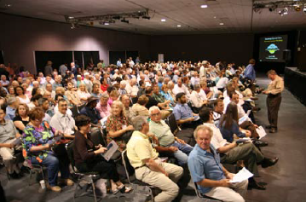

Slide 44
What : The Plan

Slide 45
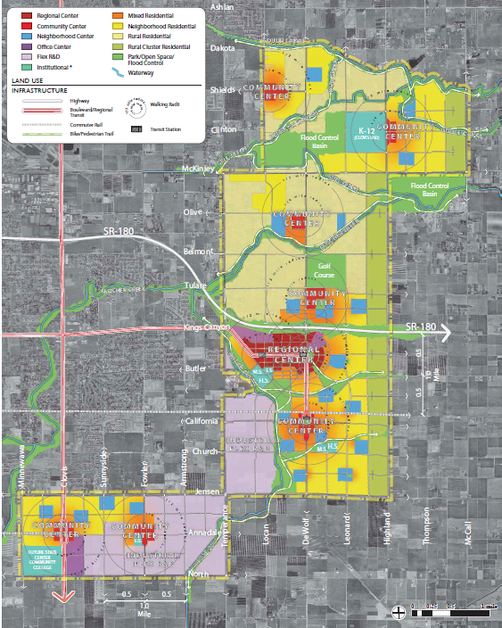
45,000 housing units
37,000 jobs
Phased over 20 years

Slide 46
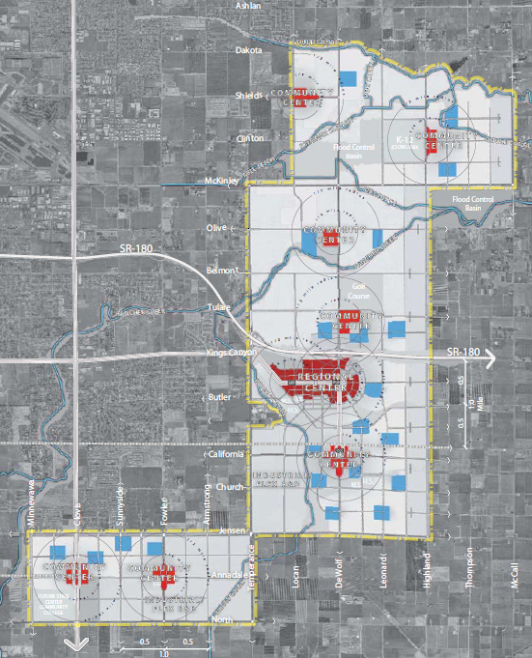

Slide 47
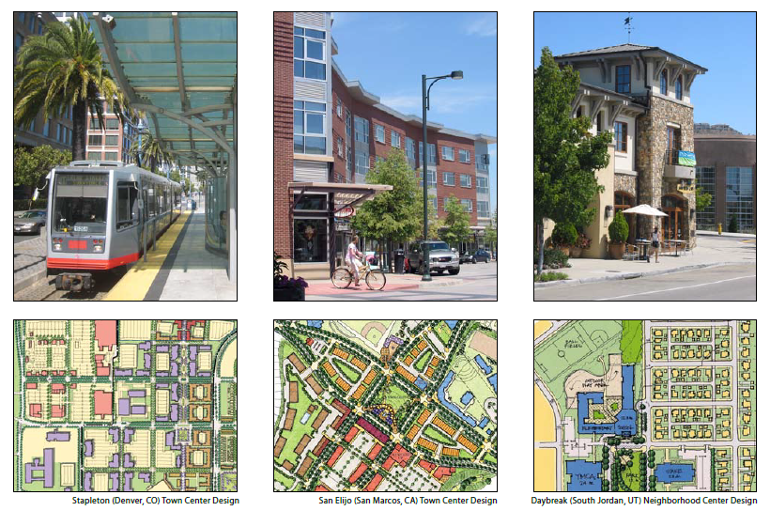

Slide 48
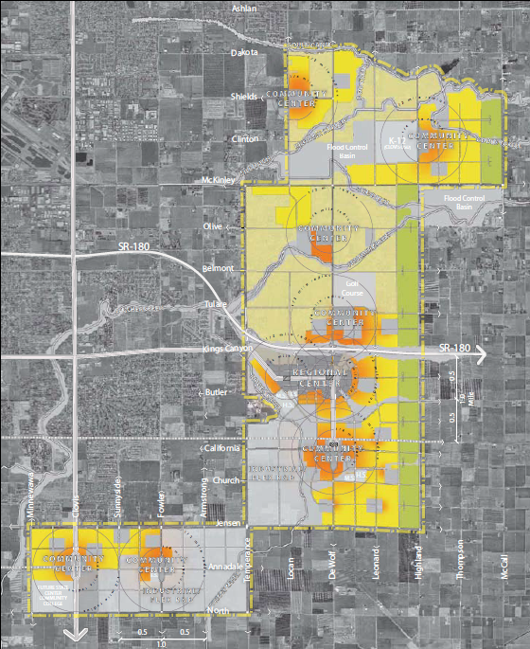

Slide 49
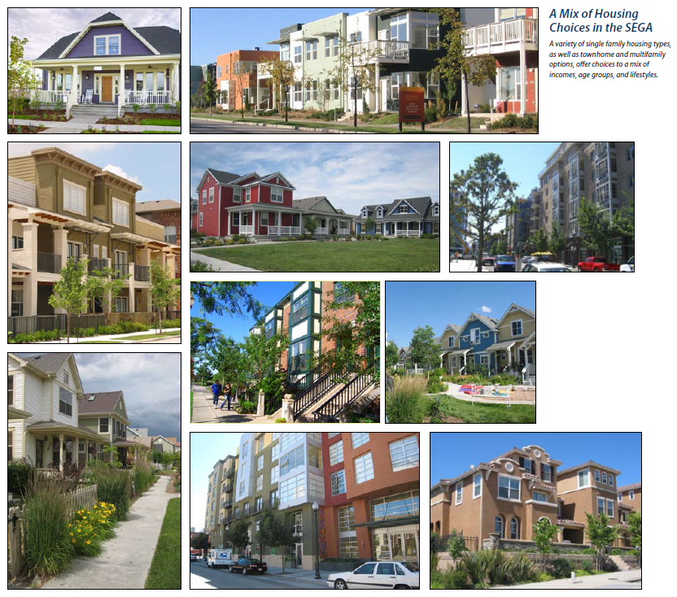

Slide 50
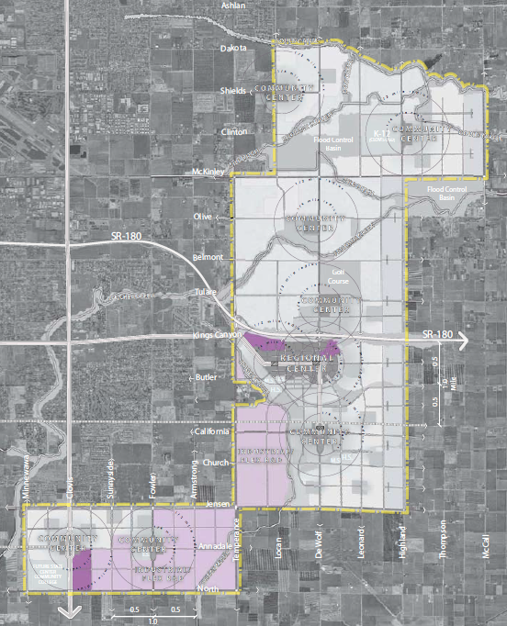

Slide 51
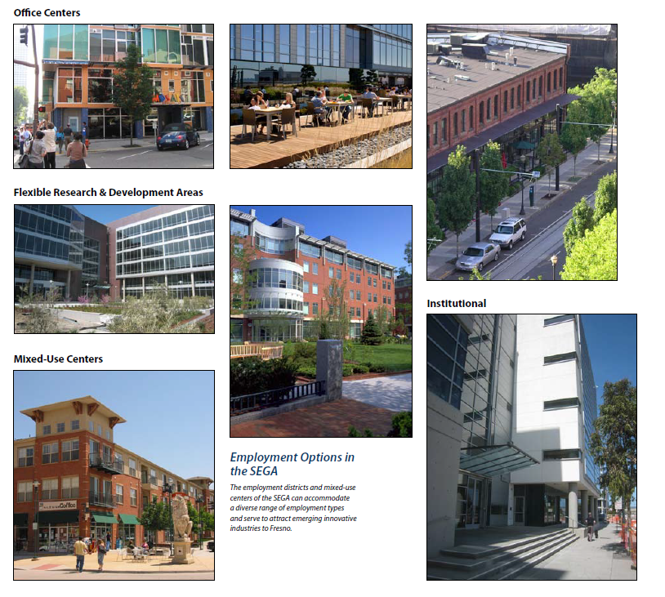

Slide 52
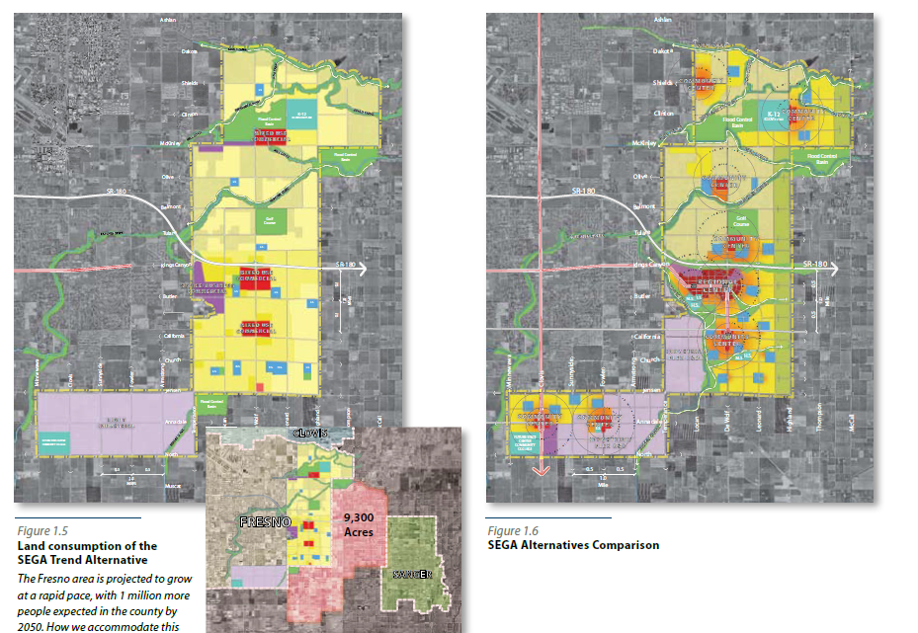

Slide 53
How Can You Influence the Plan?
Policy Ideas
Phasing Input
Implementation Ideas

Slide 54
1
4
3
2

